Slide 1
COVID-19 communications Department of Customer Service
MP's Toolkit: 18 March 2022 update
Multicultural focus

Slide 2
Purpose of this toolkit
This toolkit contains the latest links and assets to help you communicate with your community.
Topics include:
COVID-19 vaccination and boosters
Information for people exposed to COVID-19 and managing COVID-19 at home
COVID-19 testing
The latest information can be found at nsw.gov.au
Other important support and information:
Free translation and interpreter 24-hour helpline TIS National 131 450 ​
National Coronavirus Helpline 1800 020 080 (and choose Option 8 for the free interpreting service)
For people who have tested positive to COVID-19 - NSW Health COVID-19 Care at Home Support Line on 1800 960 933
For households that are required to self-isolate - NSW Health Isolation Support Line on 1800 943 553
Service NSW 13 77 88

Slide 3
COVID-19 vaccination and boosters
1

Slide 4
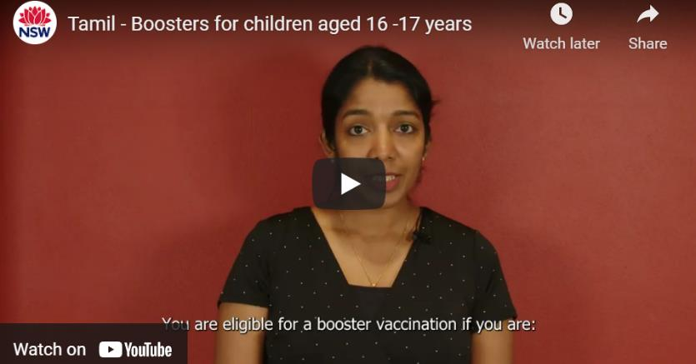
COVID-19 boosters for 16-17 year olds: videos
Note: The languages in bold have been added since the last update
Share COVID-19 booster video for people aged 16-17 years:
Kurdish Kurmanji, Macedonian, Tamil
Post copy:​
COVID-19 boosters are available for people aged 16 years and over and can be given 3 months after your second dose of a COVID-19 vaccine.
A booster dose helps to strengthen your immune system and improve your long-term protection against serious illness from COVID-19. The Pfizer vaccine is the approved booster vaccine for people aged 16 – 17 years.
For all translated COVID-19 vaccination content, click here

Slide 5
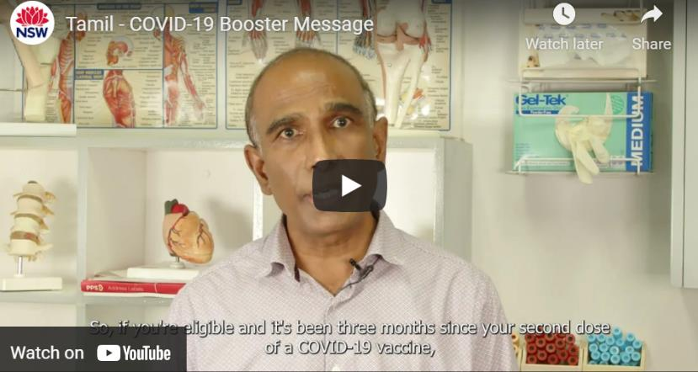
COVID-19 boosters: videos
Note: The languages in bold have been added since the last update
Share COVID-19 booster message video: ​
Bangla, Cantonese, Filipino, Gujarati, Korean, ​Kurdish Kurmanji,
Macedonian, Nepali, Tamil, Vietnamese
Post copy:​
If you're 16 years or over and had your second dose of a COVID-19 vaccine more than three months ago, your booster is due now.
For all translated COVID-19 vaccination content, click here

Slide 6
Information for people exposed to COVID-19 and managing COVID-19 at home
2

Slide 7
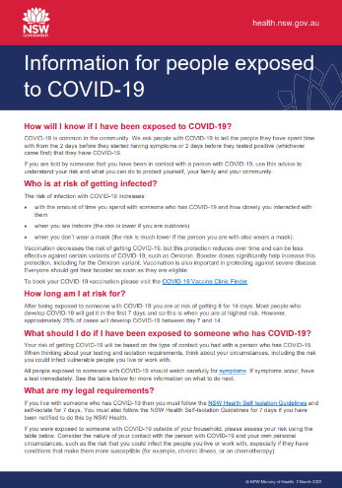
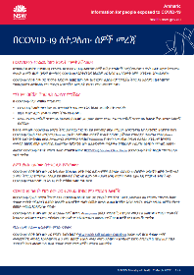
Information for people exposed to COVID-19: fact sheet
Download fact sheet:
Amharic, Arabic, Armenian, Assyrian, Bangla, Burmese, Chinese-Simplified, Chinese-Traditional, Dari, English, Farsi, Filipino, French, German, Greek, Gujarati, Hebrew, Hindi, Hungarian, Indonesian, Japanese, Khmer, Kirundi, Korean, Kurdish-Kurmanji, Kurdish-Sorani, Lao, Macedonian, Malayalam, Mongolian, Nepali, Polish, Portuguese, Russian, Rohingya, Serbian, Sinhalese, Somali, Spanish, Swahili, Telugu, Thai, Tibetan, Turkish, Urdu, Vietnamese
For all translated Managing COVID-19 content, click here

Slide 8
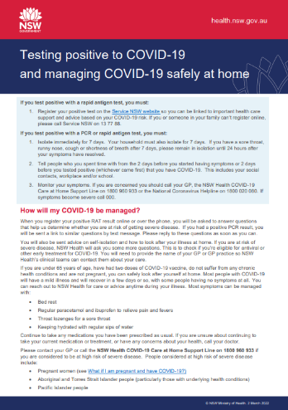
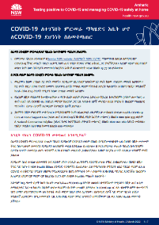
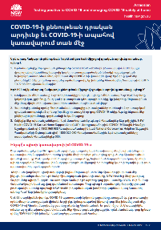
Managing COVID-19 at home: fact sheet
Download fact sheet:
Amharic, Arabic, Armenian, Assyrian, Bangla, Bosnian, Burmese, Chinese-Simplified, Chinese-Traditional, Croatian, Dari, Farsi, Fijian, Filipino, French, German, Greek, Gujarati, Hazaragi, Hebrew, Hindi, Hungarian, Indonesian, Italian, Japanese, Khmer, Kinyarwanda, Kirundi, Korean, Kurdish-Kurmanji, Kurdish-Sorani, Lao, Macedonian, Malayalam, Maltese, Mongolian, Nepali, Pashto, Polish, Portuguese, Punjabi, Rohingya, Russian, Samoan, Serbian, Sinhalese, Somali, Spanish, Swahili, Tamil, Telugu, Thai, Tibetan, Tongan, Turkish, Urdu, Vietnamese
For all translated Managing COVID-19 content, click here

Slide 9
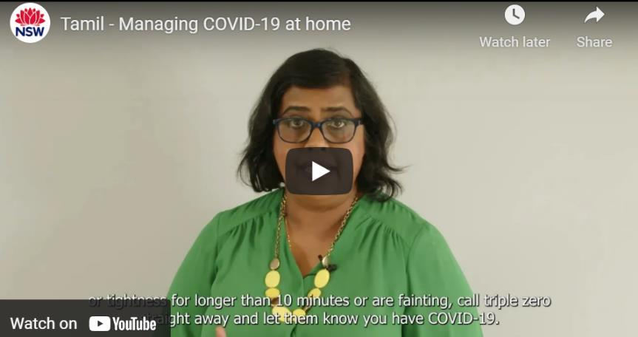
Managing COVID-19 at home: videos
Note: The languages in bold have been added since the last update
Share Managing COVID-19 at home video:
Bangla, Filipino, Gujarati, Korean, Kurdish Kurmanji, Macedonian, Nepali, Tamil, Vietnamese
Post copy: Most people with COVID-19 can recover safely at home. Know what severe symptoms to look out for so you know when to seek help.
For all translated Managing COVID-19 content, click here

Slide 10
Preparing for self-isolation: explainer audio
Overview This information is about self-isolating at home if you or someone you live with has COVID-19.
Post copy: Preparing for self-isolation
If you need to self-isolate at any time, or are self-isolating now, it is important you have enough essential food, drink and household items to last a few days at home.
Ensure you have a two-week supply of your usual medications, and pain relief such as paracetamol, a thermometer and rapid antigen tests if available. Keep enough cleaning products to wipe down surfaces, and hand sanitiser.
Have a supply of masks. Make sure you have enough supplies for infants and children such as nappies or toys.
Keep phone numbers of your GP and emergency contacts handy.
Audio clip to share: Arabic, Assyrian, Bosnian, Croatian, Italian, Macedonian, Mandarin, Spanish, Vietnamese
For all translated Managing COVID-19 content, click here

Slide 11
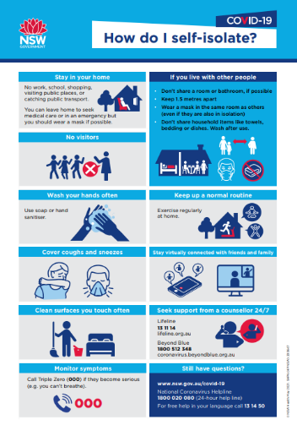
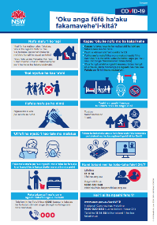
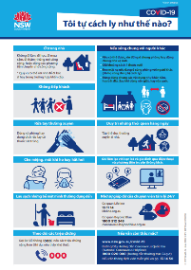
How to self-isolate: infographic
Download fact sheet:
Arabic, Assyrian, Bangla, Chinese-Simplified, Chinese-Traditional, Dari, English, Farsi, Greek, Hindi, Italian, Khmer, Korean, Lao, Nepali, Punjabi, Samoan, Spanish, Thai, Tongan, Vietnamese
For all translated Managing COVID-19 content, click here

Slide 12
COVID-19 testing
3

Slide 13
Rapid antigen testing: videos
Note: The languages in bold have been added since the last update
Live YouTube links to share:
Arabic, Assyrian, Bangla, Cantonese, Dari, English, Filipino, Greek, Hindi, Hungarian, Japanese, Korean, Lao, Macedonian, Mandarin, Portuguese, Sinhalese, Spanish, Tamil, Vietnamese
Post copy:​
Rapid antigen tests are quick and easy to use. Watch this video to learn how to use a test safely at home. Remember, if your test result is positive, you must register the result straight away online with Service NSW.
For all translated COVID-19 testing content, click here

