Slide 1
Together We’re Better - Training Workshop
Working together to improve health outcomes for people with intellectual disability
20 October 2025

Slide 3
Housekeeping
Please ensure your phone is switched off or on silent
Bathrooms are located outside the training rooms
In the event of an emergency, please follow CESPHN staff instructions
Sign on sheet
QR Code: Pre-survey
Introductions

Slide 4


CESPHN and Project GROW

Slide 5
Session Plan & Learning Outcomes:
Session 1 | Health issues experienced by people with intellectual disability in Australia Increase understanding of preventive health for people with intellectual disability Understand the Roles and responsibilities of the support team | 9.30am
 | Morning tea | 10:45am
Session 2 | Learn what reasonable adjustment means and develop a one- page health profile to include this information Case Study Activity: Create a one-page health profile based on a provided scenario Explore intellectual disability and mental health with Gavin Begbie The Annual Health Assessment Process | 11:00am
 | Lunch and networking | 12:40pm
Session 3 | Learn about the Intellectual Disability Specialists Health Service Teams with Kim Bonnici & Gavin Begbie Engage in a session with Dr. Jessica Murphy to learn how to work collaboratively with GPs and general practices Better understand GP appointment types | 1:10pm
 | Afternoon tea | 2:45pm
Session 4 | Explore approaches to palliative and end of life care with Maria Heaton Panel Discussion: Q&A Learn about Project Grow and review the key learnings of the day | 3:05pm
 | Evaluation and workshop completion | 4.00pm
Notes:
Session overview
What the day is about, what it’s not about
Focus on annual health assessment but can be applied more broadly
We’re not providing new groundbreaking information today, a lot you will already know these things, this workshop is trying to prompt you to think about why you’re doing them, and support you to do them more effectively.
Any questions – everyone has sticky notes in front of them, jot down any questions and put on the whiteboard, we will have some time through to ask questions however there is a lot of people so we may have to put a hold on questions/discussion during the day and we’ll return to it during the afternoon session. NO STUPID QUESTIONS SESSION!
Increase understanding of preventative healthcare and importance of annual health assessments for the people you support.
Understand the roles and responsibilities of the support team.
Morning tea
Increase knowledge of how to prepare and implement an annual health assessment process and support better health outcomes for the clients you support.
Learn (or better understand) what reasonable adjustment means to ensure health appointments are successful for everyone involved.
Lunch and networking
How to work collaboratively and foster relationships with GPs and GP practices.
Gain detailed knowledge about Medicare and how to work collaboratively with GPs to support effective health care.
Afternoon tea
Q&A time, session wrap-up and evaluation.
Evaluation and workshop completion
Go out and give it a go, we’ll host online session (community of practice vibe) where we want to hear how this goes in practice…

Slide 6
Compared to the general population,
People with intellectual disability experience
more than twice the rate of avoidable deaths;
twice the rate of emergency department and hospital admissions;
substantially higher rates of physical and mental health conditions; and
significantly lower rates of preventative healthcare.
Notes:
The health of a person with ID as we know often has a number of comorbidities which comes with their syndrome or overall diagnosis.
Chronic diseases that frequently affect people with disability are diabetes, heart disease, high blood pressure, gastro-intestinal conditions, mental illness, tooth and gum disease and lung disease.
Historically this often means that the person is often experiencing health disparities related to poor access to high quality medical care, inadequate preparation of health care providers to meet their needs and the social determinants of health and failure to people in preventative activities
Therefore the rates of physical and mental problems increase as the person can not access those services they need to get on top of the various issues they experience.
People aged under 65 years with severe profound disability had a higher prevalence of long-term health conditions than those without aa disability.
The person with a disability does experience long term health conditions and the relationships between mental and physical conditions and severity of disability are complex and often place them in the position of suffering more, having their condition often unrecognised, misdiagnosed and poorly managed.
Q: Do they understand their role as medical advocate?
Reflect on these statistics and ask for feedback from the participants about their skills in advocacy based on these inequities for the person and the high levels of misdiagnosed and poorly managed conditions.
What role does the support worker play in preventative health? Discuss some innovative ways to do this within the group home you work.

Slide 7
What we know about People with intellectual disability
More likely to be overweight or obese
Consume diets higher in fat and sugar (fast food!)
Don’t get enough exercise
Are more likely to have substantial oral health problems
Likely to have multiple health issues
Take multiple medication
Higher rates of mental health issues

Slide 8
Chronic diseases that people with disability commonly experience
diabetes
heart disease
lung diseases
tooth/gum disease
high blood pressure
gastro-intestinal conditions
mental illness
Notes:
A chronic disease is one that has been (or is likely to be) present for at least six months. It often has more than one cause, is long term, causes some form of disability and is rarely cured completely. People with disability are more likely to have a chronic disease, and to have it occur earlier, than people without disability.
Examples of chronic disease
Chronic diseases that occur commonly in all people are asthma and other lung diseases, cancer, diabetes, heart disease and diseases of bones and joints.
Chronic diseases that frequently affect people with disability are diabetes, heart disease, high blood pressure, gastro-intestinal conditions, mental illness, tooth and gum disease and lung diseases.
Risks associated with chronic disease
Lifestyle and behaviours that are known to cause and worsen chronic disease
insufficient physical activity
excessive alcohol consumption
People with disability are more often represented in ‘at risk’ groups for acquiring a chronic disease for example by, being overweight, having unhealthy eating habits, being smokers and engaging less in physical activity.
Importance of managing chronic disease
When chronic disease is not managed, people can experience mental, emotional and physical ill health, pain, unplanned encounters with the health system and hospital admissions, disability and premature death.
Mobility &Communication- people with limited communication/ mobility support
Health assessments- date of health assessments unknown
Weight, exercise and lifestyle risks- over ½ the people who died were outside the healthy weight range
High prevalence of known risk factors including obesity, hypertension, diabetes, low physical activity levels, hypertension
Lack of care co-ordination between services to address identified risk factors

Slide 9

When chronic disease is NOT addressed
A person can experience
Mental, emotional and physical ill health,
Unnecessary pain,
Unplanned encounters with the health system and hospital admissions,
Disability and premature death.

Slide 10
Activity
Review the list of specific health issues provided and pick out the health issues that the people you support experience.
Take 5 minutes to discuss with your group, collate your responses and place on the whiteboard.
Notes:
Reflecting on what you can do working in this space to improve the health of the person. What interventions do you know are working currently in your house.
Prevention is a part of our daily habits and actions.
Simple everyday examples:
hand-washing helps to prevent the spread of infectious diseases
a nutritious diet and regular physical activity not only improves our physical health, but also our mental health and wellbeing
wearing a hat and applying sunscreen protects against the development of skin cancer
getting vaccinated helps build our immune system.
Q: Now you are more aware of those inequities of the persons health care. What you do you think is needed. What are the some of the interventions that are working.

Slide 11
What is preventive health?
Notes:
Q: What is preventable health?
“Health is a state of complete physical, mental, and social wellbeing and not merely the absence or presence of disease or infirmity.”
Q: How much of the care you deliver is reactive health care (hospitalisation- consequence of not regularly screening)
Q: At what cost to the organisation?
Why is it important for people with ID? (next slide)

Slide 12

Preventive Health
Looking after our body and mind by eating well, being active, getting vaccinated and avoiding risky behaviours – like smoking or drinking too much – can prevent many diseases and keep us healthy and well.
We work to enable healthy living through supportive environments.
https://www.health.gov.au/topics/preventive-health/about
Notes:
Key components of preventative health in Australia include:
Health Education and Promotion: Initiatives that educate the public about healthy lifestyles, nutrition, physical activity, and the importance of regular health screenings.
Vaccination Programs: Immunization campaigns to protect against infectious diseases, such as the National Immunisation Program, which provides vaccines for various age groups.
Screening and Early Detection: Programs that encourage regular health screenings for conditions such as cancer, diabetes, and cardiovascular diseases, facilitating early diagnosis and treatment.
Chronic Disease Prevention: Efforts to reduce the incidence of chronic conditions through lifestyle interventions, such as smoking cessation, healthy eating, and physical activity promotion.
Mental Health Initiatives: Programs aimed at promoting mental well-being and preventing mental health issues through support services and community engagement.
Environmental Health: Addressing factors in the environment that can impact health, such as air and water quality, to prevent health issues related to environmental hazards.
Preventative health is a key focus for the Australian healthcare system, with policies and programs designed to improve population health outcomes and reduce the burden of disease on individuals and the healthcare system.

Slide 13
It’s what we do each day to stay healthy and well and reduce the risk of illness
We exercise, eat a healthy diet, we drink less, stop smoking
We have regular health check with our GP and screening when needed
We have our vaccinations
We take medication for identified health issues
We look after our mental health

Slide 14
Preventative Health Screening
Cancer Screening: Breast, cervical, bowel (with accommodations).
Cardiovascular Health: Blood pressure, cholesterol, and diabetes screening.
Immunizations: Routine vaccinations (influenza, etc.).
Vision & Hearing Tests: Regular checks.
Dental Check-ups: Preventative dental care.
Mental Health Checks: Assessment for depression and anxiety

Slide 15
Preventative healthcare for people with intellectual disability
How do you know if the people you support have access to
Preventative Health Screening?
Notes:
Preventative health measures in Australia encompass a wide range of initiatives aimed at promoting health and preventing disease. Here are some notable examples:
Vaccination Programs:
The National Immunisation Program (NIP) provides free vaccines for children, adolescents, and certain adults to protect against diseases such as measles, mumps, rubella, and influenza.
Health Screenings:
BreastScreen Australia: A national program offering free mammograms every two years for women aged 50 to 74 to detect breast cancer early.
National Cervical Screening Program: This program encourages women aged 25 to 74 to undergo regular cervical screenings to detect precursors to cervical cancer.
Bowel Cancer Screening Program: A program that provides free screening kits to eligible Australians aged 50 to 74 for early detection of bowel cancer.
Chronic Disease Prevention Programs:
Heart Foundation’s Healthy Heart Program: Offers resources for maintaining heart health through diet, exercise, and regular check-ups.
Diabetes Prevention Programs: Initiatives aimed at educating at-risk populations about lifestyle changes to prevent type 2 diabetes.
Mental Health Initiatives:
Beyond Blue and Lifeline: Organizations providing resources, support, and education to promote mental well-being and prevent mental health issues.
Mental Health First Aid: Training programs designed to equip individuals with the skills to help someone experiencing a mental health crisis.
Tobacco Control Measures:
Strict regulations on tobacco advertising, plain packaging laws, and public smoking bans to reduce smoking rates and prevent smoking-related diseases.
Nutrition and Physical Activity Programs:
The Australian Dietary Guidelines: Provide evidence-based recommendations on healthy eating to promote good nutrition.
Get Up & Grow: A program aimed at promoting physical activity and healthy eating among young children and their families.
Community Health Initiatives:
Walk to School Day and other community events that encourage physical activity and healthy lifestyles among children and families.
Programs targeting social determinants of health, such as housing, education, and employment, to improve overall community well-being.
HIV Prevention Programs:
Initiatives such as PrEP (pre-exposure prophylaxis) and comprehensive sexual health education to reduce the transmission of HIV and sexually transmitted infections.
These measures reflect Australia's commitment to a preventative health approach, aiming to enhance population health and reduce the incidence of preventable diseases.
Whiteboard responses;
Mealtime management
Epilepsy Management Bowel Management
Bowel Management ( constipation)
Wound management
Medication administration
Mental Health
Pian management
Weight management/ nutritional issues
Oral Care issues
Vision/ hearing impairment
Polypharmacy

Slide 16
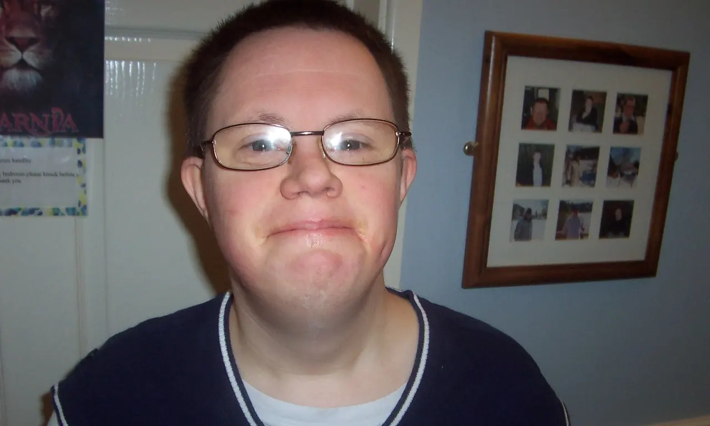
What happened when a support team didn’t fully understand Richards complex health needs
Notes:
Richard’s story. He lived in the UK……….
This is Richard.
Richard had Down’s syndrome, psychosis and a mischievous sense of humour. He loved theme parks, theatre classes, watching ‘Mr Bean’ and tickling people’s toes! Richard also had constipation from birth. There’s nothing glamorous about ‘poo’ but his parents understood Richard’s needs and did their best to make toileting fun! Laughter could be heard from the bathroom every night, as his parents helped Richard to relax and encouraged bowel movements.
When Richard left home, assessment reports by professionals said very clearly that his constipation would always need close monitoring and support and that constipation should always be considered as a potential cause, when his mental health deteriorated. Somehow, this knowledge was lost over the years.
Richard sadly died very suddenly in 2012 as a result of unmanaged constipation. He was only 33 years old. Over 10kg of faeces was removed from Richard’s bowels before he died and his bowel was 18cm diameter at post-mortem. His psychiatrist and GP had both seen him that week but did not recognise the extent of faecal impaction. Richard’s withdrawal and distress were attributed to his mental health and a mental health admission was arranged, when he actually needed urgent medical attention.
When Richard was finally admitted to hospital, his assessment and treatment were inadequate, the faecal impaction persisted and he aspirated gastric contents and died. It is difficult and harrowing to imagine how much pain and discomfort Richard must have been in, for quite some time.
This is an extract of a piece written by Richard’s sister Emily, a senior psychologist employed in a mental health service for people with disability in the UK.

Slide 17


First ever scoping review of causes and contributors to deaths of people with disability in Australia
Lead by:
Professor Julian Trollor
Chair, Intellectual Disability Mental Health, Head of Department of Developmental Disability Neuropsychiatry
j.trollor@unsw.edu.au
Dr Carmela Salomon
Senior Research Officer, Department of Developmental Disability
Neuropsychiatry
c.salomon@unsw.edu.au
University of New South Wales,
Sydney
Notes:
Key findings were evidence of:
mental health concerns including depression, self harming behaviours and anxiety.
Considerable proportion of people experienced issues affecting their eating or drinking including dental problems and swallowing problems, medication and disease processes
higher rates of polypharmacy including psychotropic medications being commonly prescribed to the person who had dies often in absence of diagnosed mental illness
Dates of last comprehensive health assessments was unknown for a number of people who died
About half the majority of people were outside the healthy weight range with their exercise status unknown - suggesting no monitoring had occurred.
This report summary is the first of its kind to provide a national baseline picture of death trends and related factors by drawing on published state andterritory level disability death review data.
The report details findings from the death reviews of 901 people with disability providing across the states of Vic, QLD and NSW. Deaths span a time period of 2007-2018. Along with insight into mortality rates and causes, the report highlights areas of problematic practice across jurisdictions that potentially contributed to some deaths.
If you don’t know of Trollers work, then we encourage you to view the scoping review
This research is what our project has come out of.

Slide 18
Risk and vulnerabilities of people who died
Mental Health Concerns: Depression, self-harming behaviours and anxiety
Physical health problems: Dental problems, epilepsy, constipation, urinary incontinence and Gastro Oesophageal Reflux Disease (GORD).
Swallowing & mealtime support: People who died experienced issues that may have impacted how and/or what they ate. For example: missing teeth and other dental problems, swallowing problems related to GORD, medications and disease processes
High Rates of polypharmacy were noted: Psychotropic medications were commonly prescribed to people with disability who had died, often in the absence of a diagnosed mental illness
Mobility &Communication: People with limited communication/mobility support
Weight, exercise and lifestyle risks: Over ½ the people who died were outside the healthy weight range
Notes:
Mental Health Concerns-Depression, self-harming behaviours and anxiety
Physical health problems-Dental problems, epilepsy, constipation, urinary incontinence and Gastro Oesophageal Reflux Disease (GORD).
Swallowing & mealtime support-People who died experienced issues that may have impacted how and/or what they ate. For example: missing teeth and other dental problems, swallowing problems related to GORD, medications and disease processes
Mobility &Communication- people with limited communication/ mobility support
Health assessments- date of health assessments unknown
Weight, exercise and lifestyle risks- over ½ the people who died were outside the healthy weight range

Slide 19

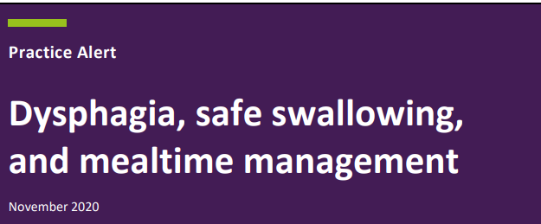



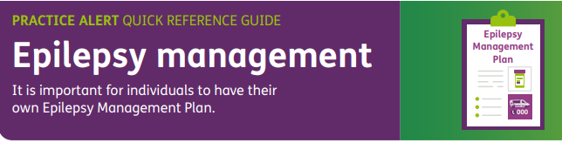
NDIS Practice Alerts
Notes:
Practice Alerts
Practice Alerts are short research summaries that provide important information on best –practice, safe and quality service delivery to people with disability. They were developed in response to the Scoping review of causes and contributors to deaths of people with disability in Australia.
New resources have been developed to complement the Practice Alert series including short animations, quick reference guides and easy reads, providing this valuable information in alternative and easily accessible formats for NDIS providers and workers.
You can access these on the NDIS safeguarding page. Very useful for discussions at team meeting and to reinforce how important preventative health and Annual health assessments are for the people they support.

Slide 20
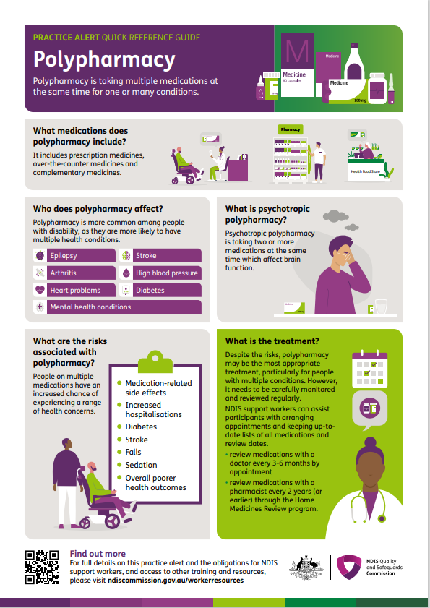
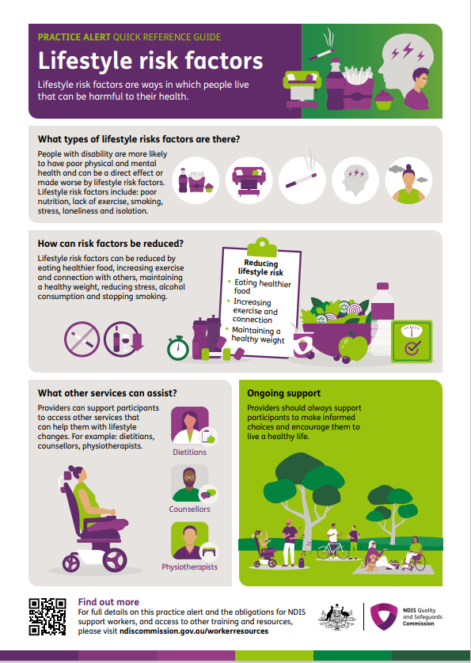
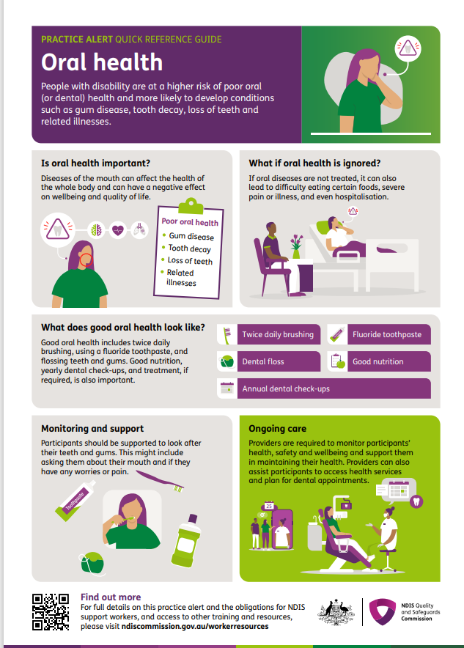
NDIS Practice Alerts quick reference guides
Notes:
Remind that there are longer versions of these.

Slide 21

NDIS Quality and Safeguards commission
https://www.ndiscommission.gov.au/workerresources
Two New Practice Alerts Launched. I will talk about these later

Slide 22
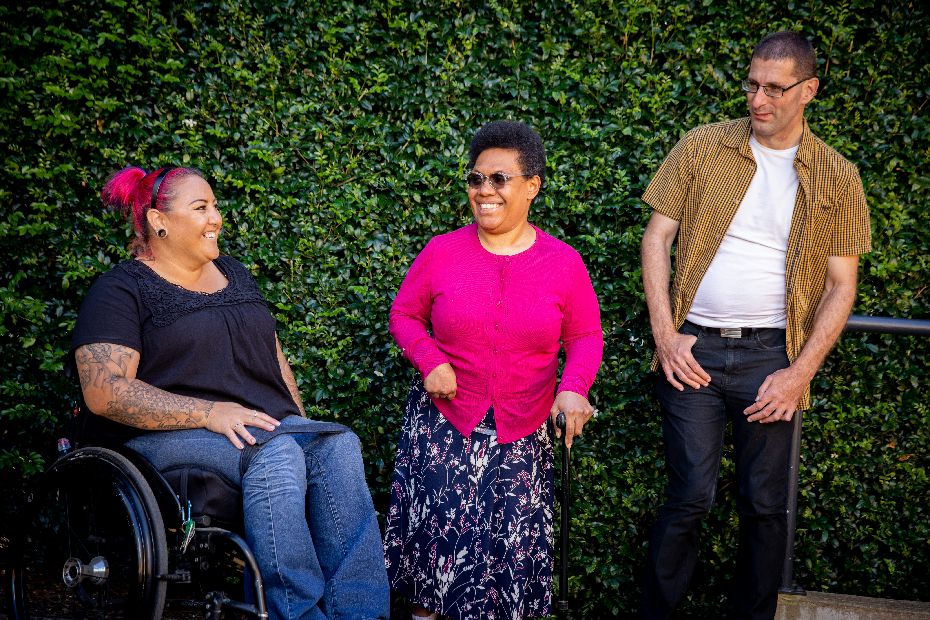

Official Community Visitor (OCV) scheme

Slide 23
Role, powers and functions of OCVs

Slide 24
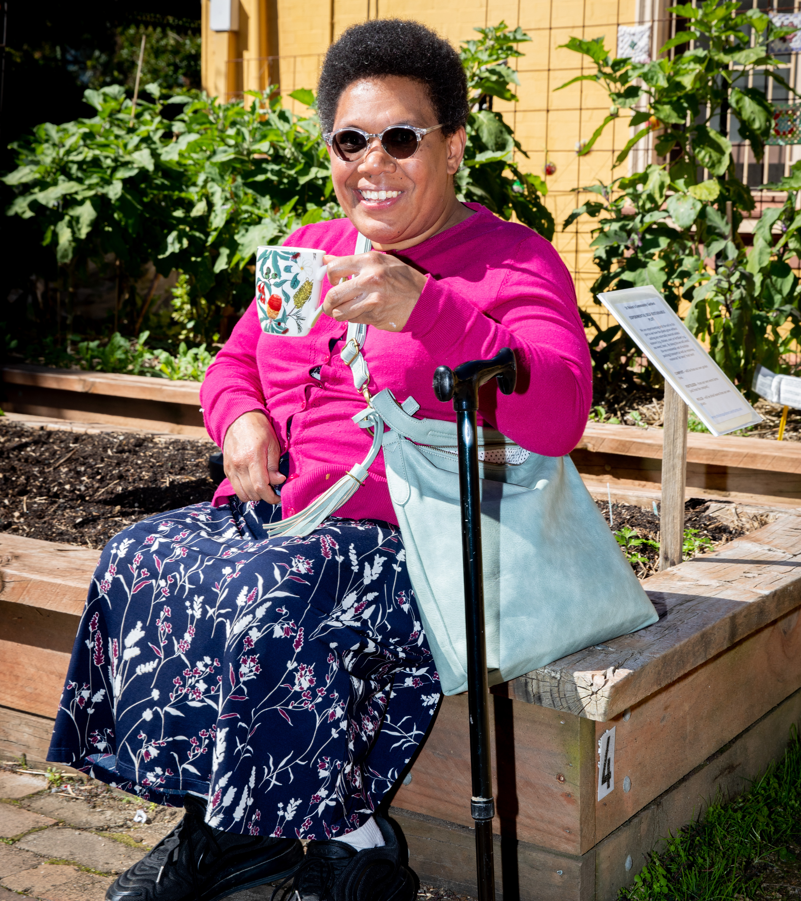
Who are OCVs?
Official Community Visitors (OCVs) are independent statutory appointees of the NSW Minister for Families and Communities and Minister for Disability Inclusion (Minister Kate Washington).
OCVs operate under the Ageing and Disability Commissioner Act 2019 (in relation to adults) and the Children’s Guardian Act 2019 (in relation to children and young people).
Notes:
The Ageing and Disability Commission manages the OCV scheme on behalf of the Office of the Children’s Guardian. The OCV scheme operates under two separate pieces of legislation, the Ageing and Disability Commissioner Act in relation to adults and the Children’s Guardian Act in relation to children and young people in out of home care.

Slide 25
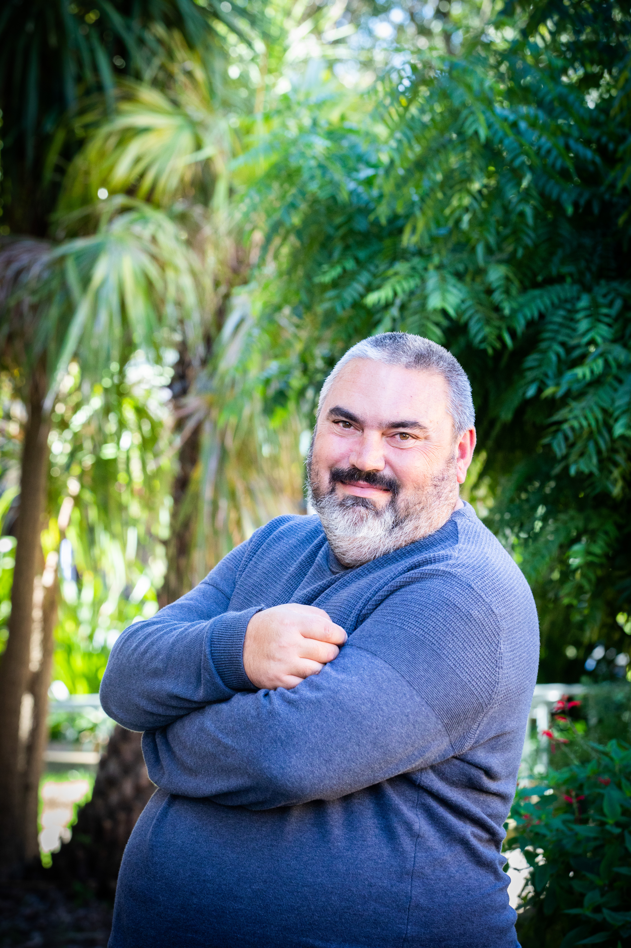
The role of the OCV’s
OCVs are independent and impartial. We are the ”eyes and ears” of the Minister, and identify and raise issues on behalf of residents.
An OCV’s central goal is to provide:
‘residents of (accommodation) services with an independent person who can (listen to) any needs, concerns or difficulties (of) clients...’
‘... safeguard against forms of system abuse by (viewing) the operations of all residential services’
Second reading speech, Community Services (Complaints, Appeals and Monitoring) Bill, 11/3/1993, by the then Minister for Community Services, the Hon. Jim Longley, MP.
Notes:
One of the most valuable things about OCVs is their independence and impartiality. They are ministerial appointees and are effectively her “eyes and ears” on the ground, in identifying and raising issues on behalf of residents.
OCVs provide an independent person that residents living in the accommodation service can raise their concerns with, telling them about any difficulties they may be facing.
The OCV scheme is seen as a form of safeguarding for residents.

Slide 26
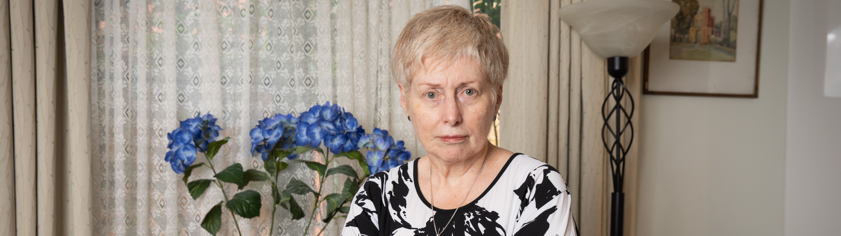

Who do OCVs visit?
Government and non-government residential services in NSW providing full-time care to:
  Children and young people in residential out-of-home-care (OOHC) or intensive therapeutic care (ITC)
  Adults with disability living in supported accommodation provided by NDIS Supported Independent Living (SIL) providers
Adults with ‘additional needs’ living in assisted boarding houses.
Notes:
OCVs visit a number of different service types including residential services in NSW providing full-time care to:
- Children and young people in residential out of home care
- Adults with disability living in supported accommodation provided by NDIS SIL providers
-Adults with additional needs living in assisted boarding houses.
I should note that full time care doesn’t necessarily equate to 24/7 support. The OCV scheme considers all services on their merits and takes a number of things into consideration including whether residents have staff support for most of their day to day care, and the residents would be unable to live independently without that support. It could include:
- staff rostered to support residents for 24 hours a day, seven days a week
- staff who are present most or all of the day, leave when residents go to bed, but are available for emergencies overnight
- At least 20 hours of direct care (drop in support) per week, without which the resident would be unable to live independently.

Slide 27
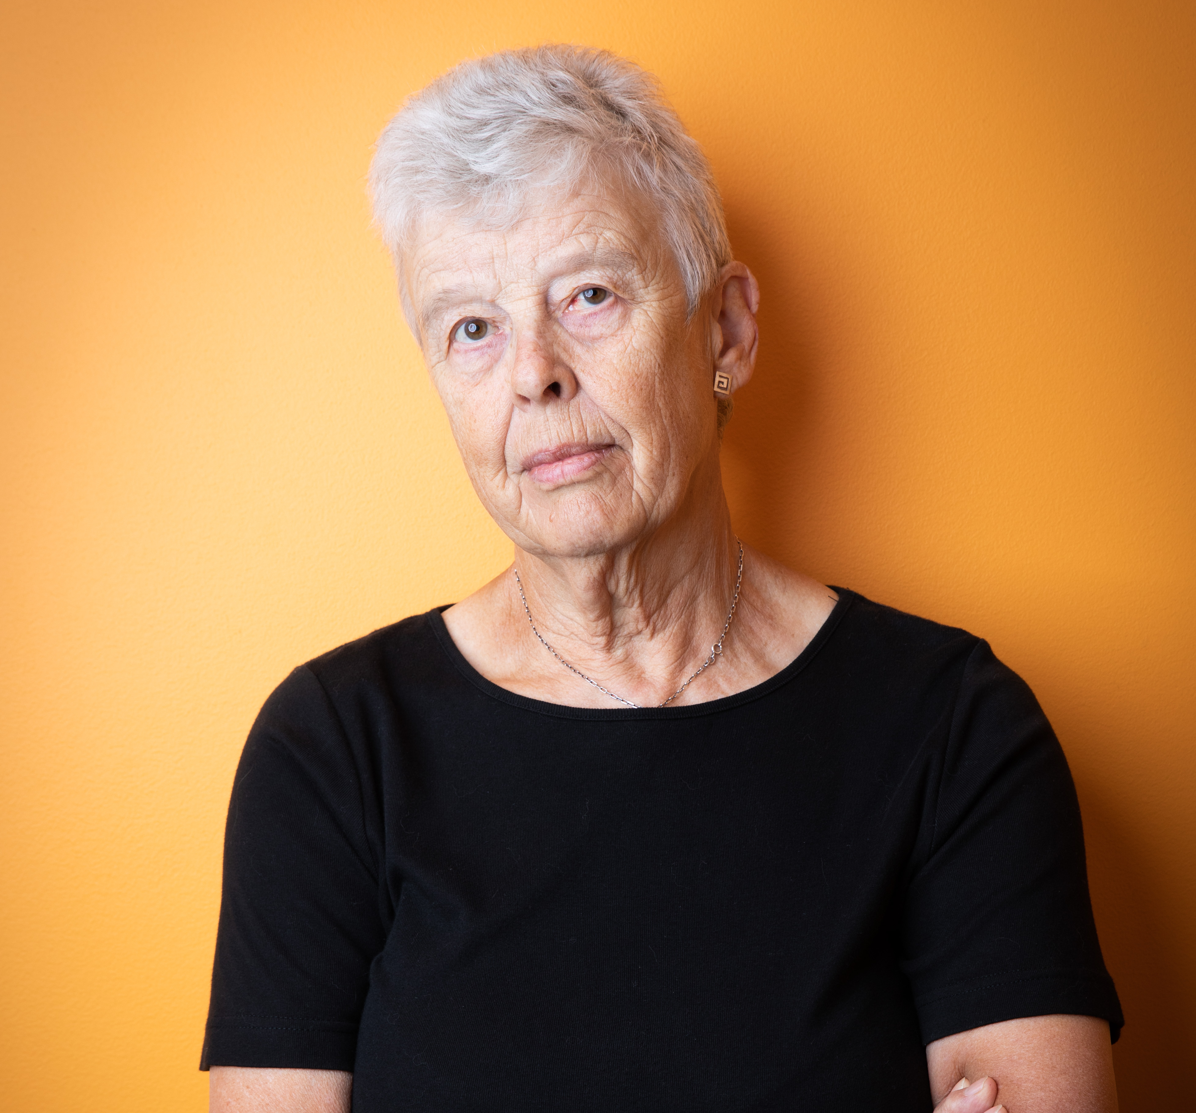

OCV Powers
Enter and inspect a visitable service at any reasonable time
Talk in private with any resident, or person employed at the service
Inspect any document held by the service that relates to the operation of the visitable service
Provide advice or information to the Minister, the Ageing and Disability Commission (ADC) and the Office of the Children’s Guardian (OCG) on matters relating to the conduct of the premises.
Notes:
OCVs have quite substantial powers. OCVs can enter a visitable service at any time. They usually visit in afternoons and on weekends when it is more likely that residents will be at home. Although sometimes they might come during the day.
OCVs are able to talk in private with any resident or staff member at the service. One of the most valuable parts of the OCV role is their engagement with the person with disability or child or young person. Hearing from them about how things are going and if they have any concerns or issues they would like to raise.
OCVs can also inspect any document held by the service that relates to the operation of the visitable service. Things they might be looking at are incident reports, health documentations such as the last time they went to the doctor or dentist. For residents of a certain age they might want to know if they have participated in the relevant cancer screening programs.
After each visit the OCV writes a visit report and sends it to the provider to respond to. Once a response is received, the OCV considers the response. They will then either: close the issue if the provider has answered the questions adequately. They might close the matter but make a note to keep an eye on things … for example if the provider says they have made a doctor’s appointment the OCV might check in at their next visit to make sure that the appointment went ahead. If the OCV is not happy with the response, they then might decide the refer the matter to the most appropriate body, such as the NDIS Commission or NSW Ombudsman.

Slide 28
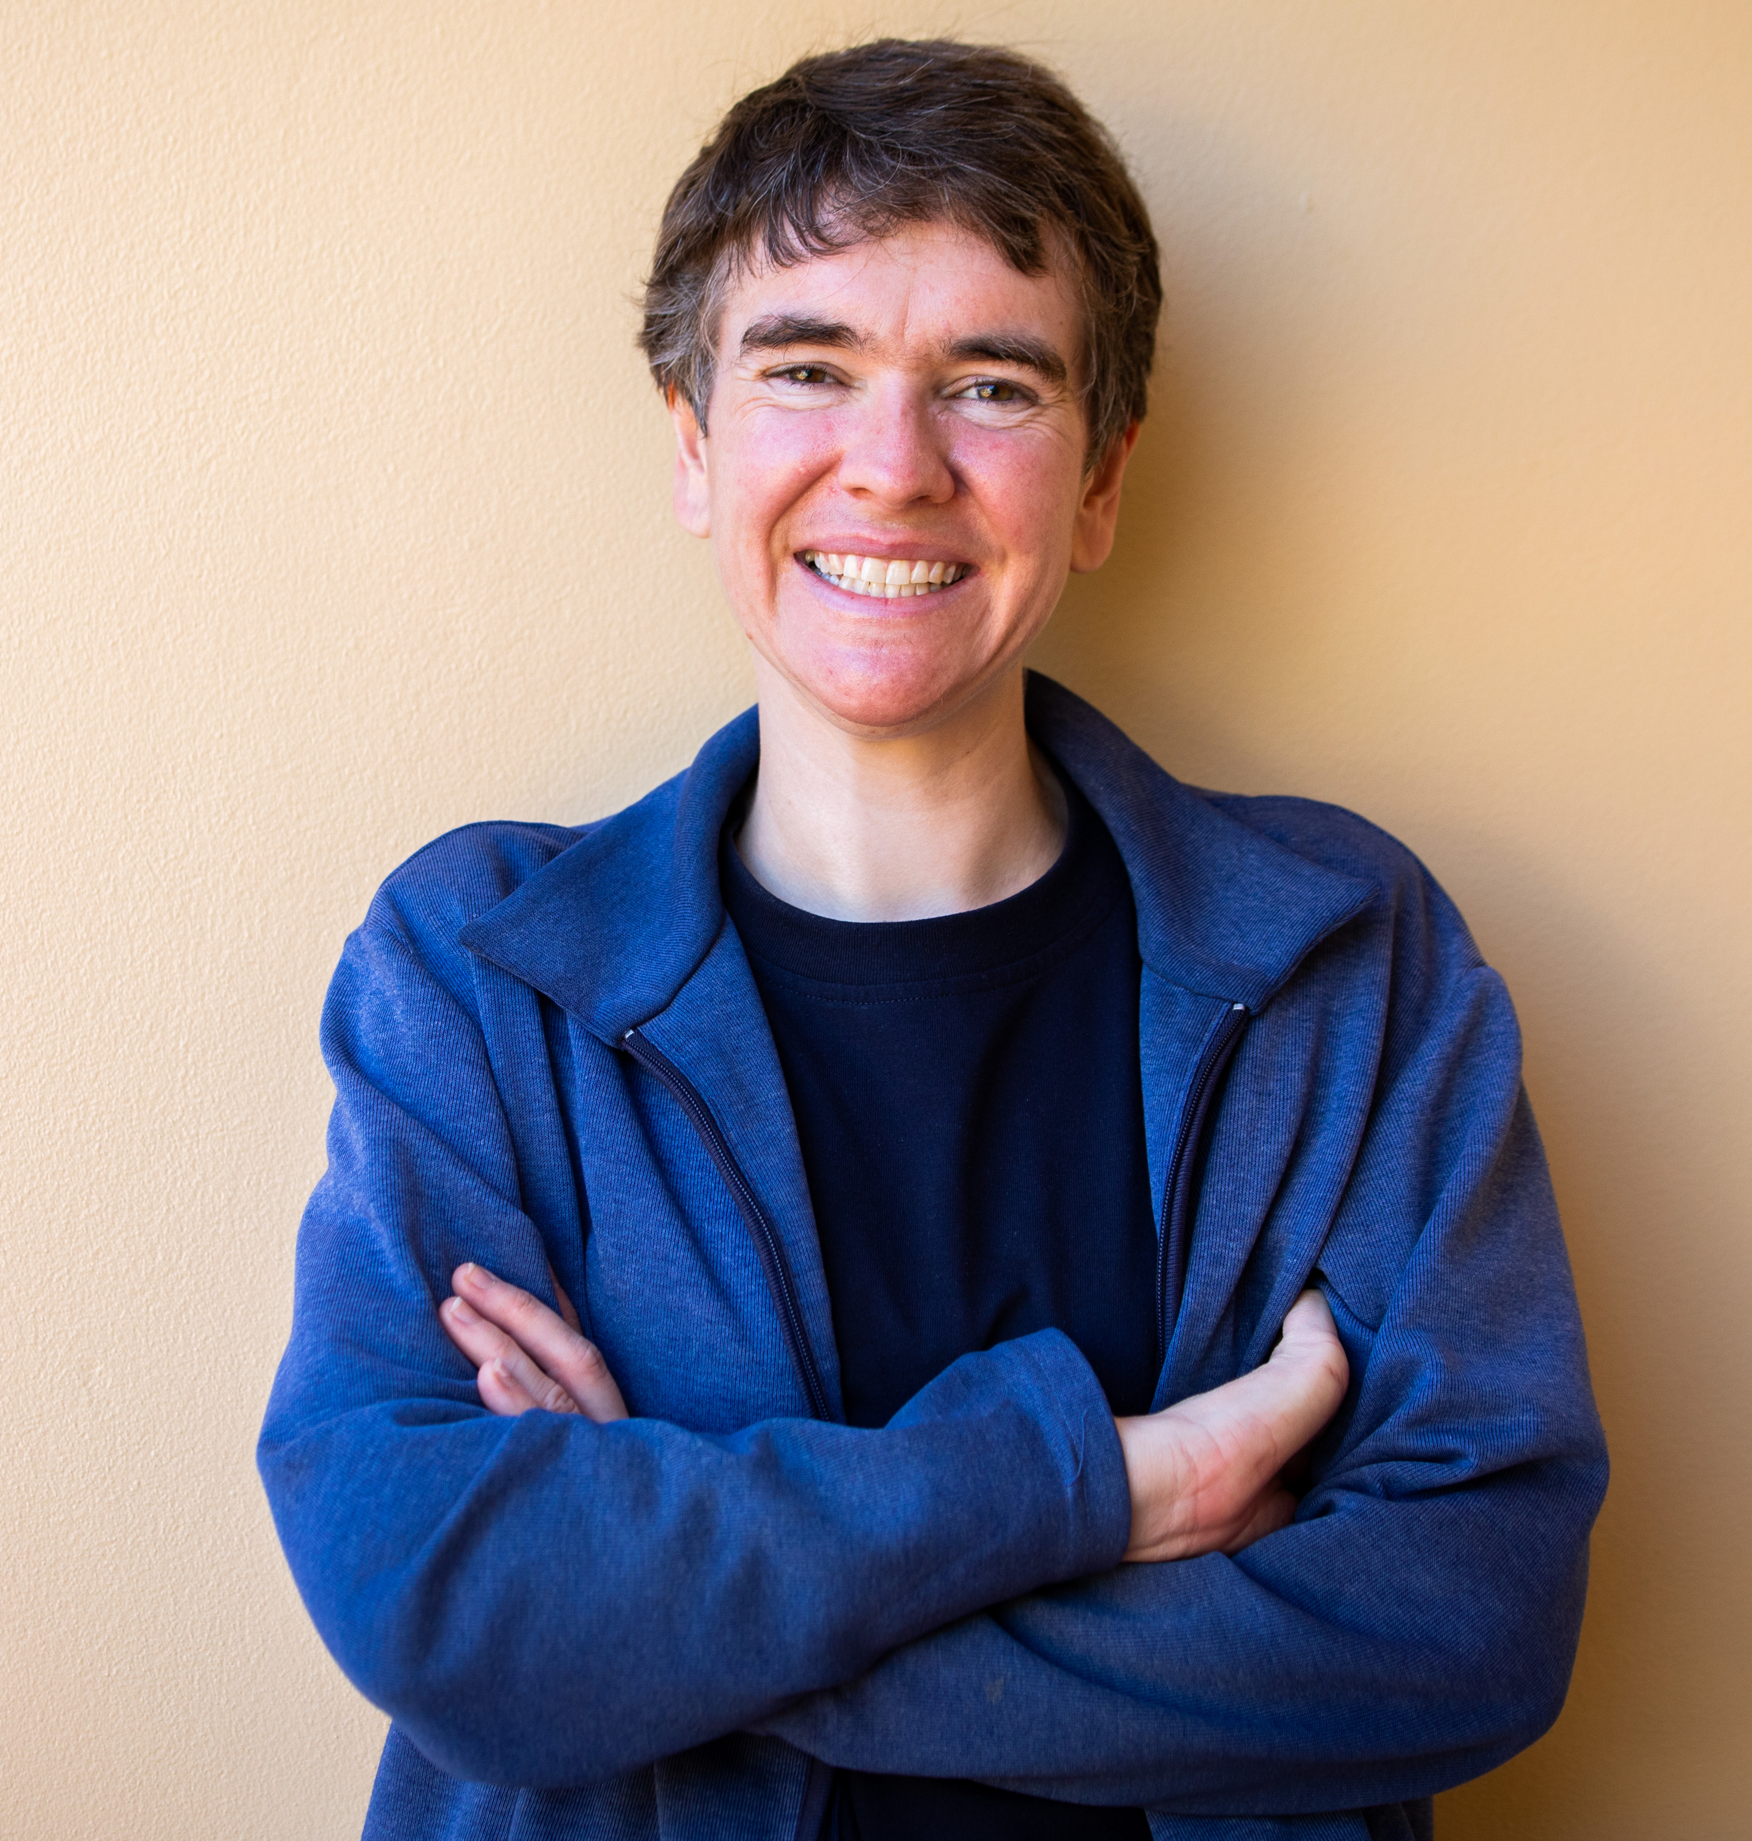
OCV Functions
Help to resolve grievances or concerns affecting residents as early and as quickly as possible by referring those matters to the service provider and other appropriate bodies
Inform the Minister, the ADC and the OCG about matters affecting residents
Promote the rights of residents
Consider matters raised by residents, staff, and other people who have a genuine concern for the residents
Provide information and support to residents to access advocacy services
Notes:
The overarching functions of OCVs is to:

Slide 29
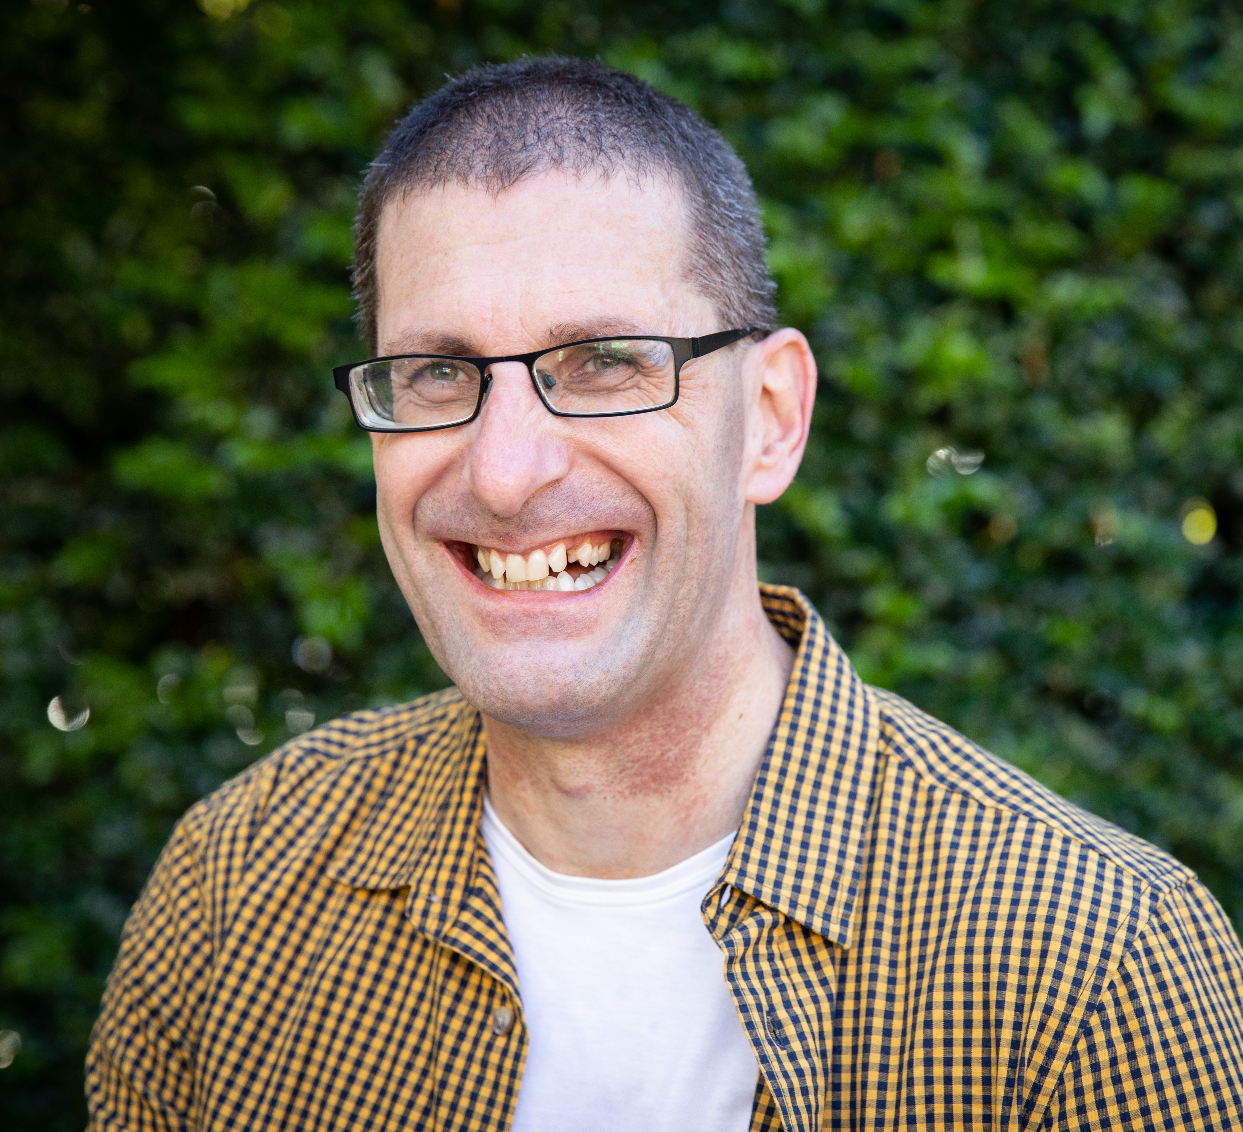
When visiting services..
OCVs listen to what residents have to say about their accommodation and support, and any issues affecting them
OCVs give information and support to residents wanting to raise matters with their service providers
OCVs help to improve outcomes for residents by identifying issues affecting residents and raising them with staff and management for resolution
OCVs provide information to residents about advocacy services, and help them to obtain advocacy support in appropriate cases.
Notes:
I just want to highlight that the resident is at the centre of the focus at OCV visits. The issues raised are about what they identify may improve the quality of life for the person.
The OCV scheme has recently introduced a systemic issues project. OCVs still look at all issues, but pay close attention to the selected systemic issues to see if they are present at the services they visit. The systemic issues identified for 2024-25 include leaving care planning (OOHC), staff training and involvement in decisions. The finding are collated at the end of the year and are included in the OCV annual report. The systemic issues for the 2023-24 year that have just been published in the OCV annual report were: Compatibility, involvement in education or vocational training, and preventative health care. The next step for these is to meet with the relevant regulatory bodies to talk about the OCV findings and discuss what strategies these agencies have in place, or will take to address the longstanding systemic issues. Although the issues have been around for a long time, the value of the systemic issues project is being able to collate and analyse what OCVs are seeing on the ground now in relation to those issues and to be able to feed this information to the agencies that have the power to do something about them.

Slide 30
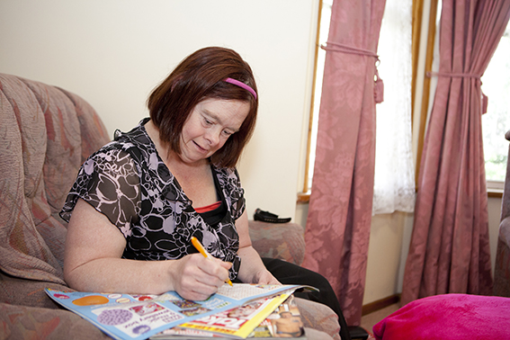
Positive outcomes from issues raised
Improved health & wellbeing from a Home Medicine Review (SIL)
Treatment commenced following cancer screening
Residents getting access to mental health services

Slide 31
Contact us
Ageing and Disability Abuse Helpline
  1800 628 221 (Mon – Fri 9am-4pm)
  nswadc@adc.nsw.gov.au
Ageing and Disability Commission
  General Enquiries 02 4904 7500 (Mon – Fri 9am-5pm)
  commissioner@adc.nsw.gov.au
  www.adc.nsw.gov.au
Official Community Visitor scheme
  02 9407 1831 (Mon – Fri 9am-5pm)
  OCV@adc.nsw.gov.au

Slide 32
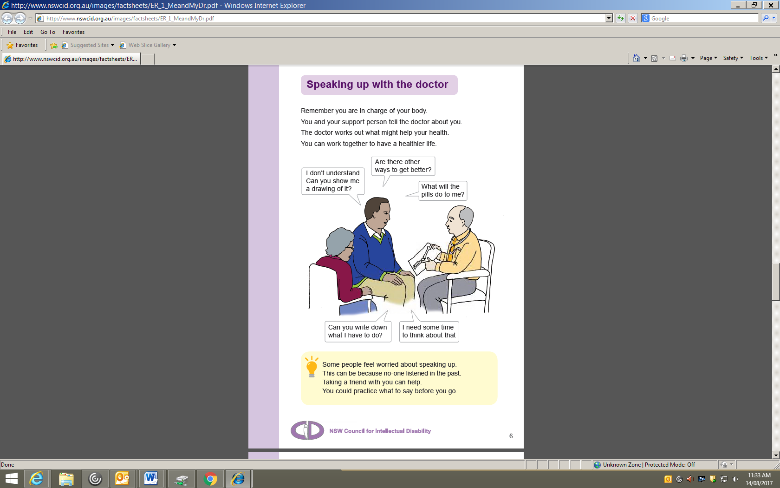
Role of Support team
"The provision of high-quality health care to people with disabilities requires effective, respectful three- way collaboration between the person concerned, carers (those supporting the person - usually Disability Support Workers and/or family members) and healthcare professionals"
Recommendations from the Health Matters A submission to the Royal Commission into Violence, Abuse, Neglect and Exploitation of People with Disability
Notes:
The need for effective teams is increasing due to increasing co-morbidities and increasing complexity of specialization of care. There is a great need for the support team to work collaboratively as we strive towards quality patient care for the person with ID.

Slide 33
Notes:
Roles and responsibilities in health planning
This is to show them that the current system is very confusing and overwhelming and to prepare them for how easy and effective the checklist is.

Slide 34
Role of disability support team
Understand the person and their specific support needs
Prepare the person for their Annual Health Assessment.
Inform the GP practice about the person's support needs and if reasonable adjustments are necessary.
Update the person’s health plan following the Annual Health Assessment, and ensure the disability support team understands the goals and actions agreed on by the GP and the person
Monitor the person's health, record and report any changes to the team,
Know what to do in a medical emergency
Notes:
Jen What can we do on a day to day basis that supports the care for the person.
Suggest we get to know more about the persons diagnosis so we can assess and monitor changes.
Examples where person is on medications and we are not sure why they are on it.
Discussions about what behaviours we have seen we are not usual and how we address them
Updating those records so we have a true picture. The incorporation of sharing responsibilities with accountability between team members in health care systems offers great benefit. However, in practice, shared responsibility without high-quality teamwork can result in immediate risks for patients. For example, poor communication between health-care professionals, patients and their caregivers, has emerged as a common reason for errors in health care. We have seen medical errors, “near misses” and other adverse events occurring due to inadequacy of communication among team members even in a well coherent team . Moreover, lack of purposeful team care can also lead to unnecessary hospitalisations for the person and thus can it important to work collaboratively to help avoiding some of these dangers occurring from not providing all the information required and not communicating the persons needs to your work team and the relevant health professionals when required. I will now hand over to Dr Jess Murphy for the role of the Gp and the practice of working more collaboratively in this space.

Slide 35
Role of GP and GP Practice
Understand the preventable causes of death of people living in care and take necessary action to prevent these issues.
Know the person, understand their disability and the specific health conditions related to that disability.
Make any reasonable adjustments necessary to facilitate medical appointments and interventions.
Conduct Annual Health Assessments - diagnose, prescribe, and coordinate treatment for health issues.
Refer to specialists as needed and ensure clarity around who is responsible for making appointments and following-up actions.
Understand the role of the person's support team in healthcare planning
Notes:
Jess speaks to this

Slide 36
How to work together
Develop a shared understanding of the person's health and support needs
Appreciate each other's knowledge and skills, and the shared responsibility for optimising the person's health and well-being
Support the person to participate as fully as possible during their appointment
Seek to understand the challenges people with disability experience in the health system and work together to improve health outcomes
Develop good relationships with all those concerned with the persons health
Notes:
Jess do this.

Slide 37
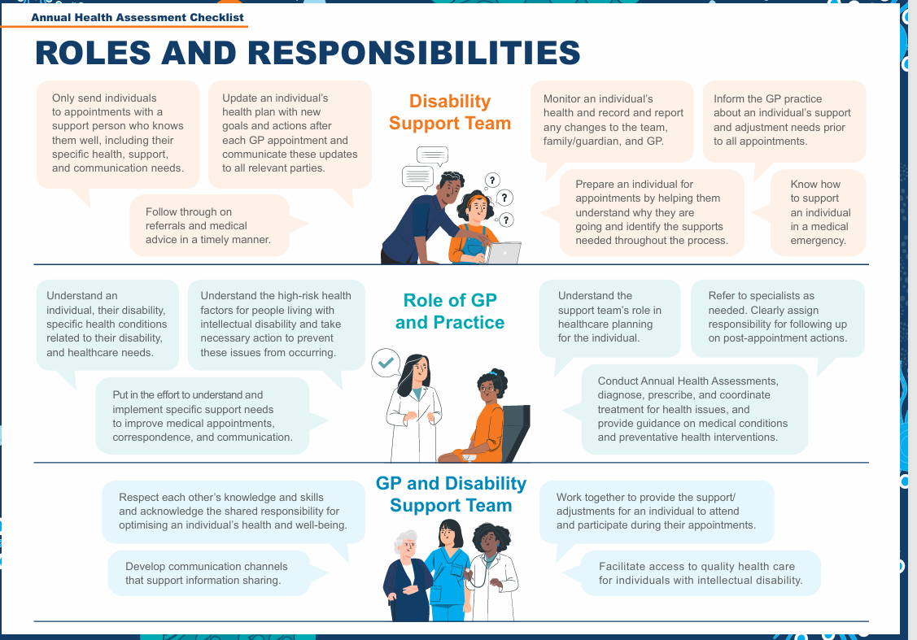

Slide 38

Do you agree with this statement?
  People with intellectual disability have poor uptake and engagement in preventative health care and access to annual health assessment compared to the general population.
  Please continue with this conversation during your break. See you in 15 minutes
Notes:
Jess -In their groups ask for them to discuss the above.

Slide 39
Break
Notes:
(15 minutes)

Slide 40
What is My Health Profile?
What are Reasonable Adjustments?
Notes:
Questions for the group:
Throughout the course of today and essentially this whole training is one big package of reasonable adjustments for people with disability.
Can you remember some of the types or areas we discussed?
And on a personal note, what are some adjustments that you need in your daily life to help you function better?
For me, I need a taller chair and desk to make sure that I am comfortable while I work.

Slide 41
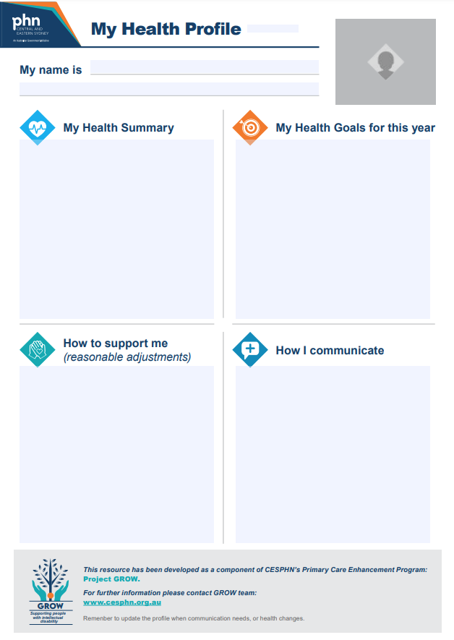
My Health Profile
1 Page Health profile that is developed between week 2-3 of the planning.
It is summary of the person’s health issues, newly identified health concerns, health goals
It includes information about how best to support the person before, during and after their appointment( reasonable adjustments)
How the person communicates
It is sent to the GP practice before the appointment
Notes:
What is the role of the support worker in conveying reasonable adjustments?
The support worker has a pivotal role in practices understanding and taking up these accommodations seriously.
Their role is not just to understand the intricacies of the necessary adjustments but how to relay there importance to the health professionals.
The impact of how the information is shared can influence how the health professional will respond. If the supporter is curt or doesn’t take the adjustments seriously the health professional might have a negative reaction or not understand the importance of them.
The support worker is responsible for conveying the adjustments in a way that evokes a positive response and action.
Activity
Hand out One-page profiles/reasonable adjustment plan
Fill in the page and include some reasonable adjustments. These can be made up or actual adjustments you need.
Only the two segments.
Find 2 other people in the group you don’t know and partner with them. !!Do not discus your adjustments
There are 3 roles, patient, Dr and support worker. Choose which role each of you will have
Hand over your profile.
Questions:
How did you feel as the patient? (Was the language supportive or apologetic?)
Did you feel they understood your needs
Is it important to have prior knowledge of a person? And not just their file.
How was it for the GP?
REMINDER: CID info calls from parents.

Slide 42
Reasonable Adjustments
Time – take time to get to know the individual.
Environment – alter the environment e.g. physical access, sensory access.
Attitude – have a positive solution orientated focus.
Communication –What’s the best way to communicate with the individual, how do they communicate. How do you communicate this to others.
Help – what assistance does the individual need and how can you support them best.
Notes:
Article 25 – Health of the convention of the rights of people with disability. 2007
States Parties shall:
1. Provide those health services needed by persons with disabilities specifically because of their disabilities, including early identification and intervention as appropriate, and services designed to minimize and prevent further disabilities, including among children and older persons;
2. Provide these health services as close as possible to people's own communities, including in rural areas;
3. Require health professionals to provide care of the same quality to persons with disabilities as to others, including on the basis of free and informed consent by, inter alia, raising awareness of the human rights, dignity, autonomy and needs of persons with disabilities through training and the promulgation of ethical standards for public and private health care;
Discussion points:
What are some things you may not have even considered?
Have you ever requested patient be seen in the car?
Asked reception calls when it’s their time and then you come into the practice.
It is important to remember that practices won’t be able to accommodate all adjustments.
You probably will need to remind the practice each time of the adjustments required, and that’s ok.

Slide 43
Reasonable Adjustments
Other adjustments:
Work with parents or carers - consulting the people who know the individual best to figure out what accommodations the individual needs. For example: When A is triggered by X, Y calms the individual down.
Team communication - It helps individuals to have all staff across reasonable adjustments.
Systems and processes.
Notes:
reasonable adjustments are accommodations made to ensure that individuals with intellectual disabilities have equal access to healthcare services.
Here are a few examples of reasonable adjustments that can be made when accessing health services:
Communication by the health professsional: Healthcare professionals should use clear and simple language, avoid medical jargon, and take their time to explain things in a way that the person can understand. They should also use visual aids, such as pictures or diagrams, to help convey information.
Supported decision making
Consent- The individuals you support should know that they can ask support staff to leave an appointment if they want to discuss something with the GP. The GP should also be asking if the person consents to the support person being in the room during the consultation.
Flexible scheduling: Individuals with intellectual disabilities may require more time for appointments or additional breaks to accommodate their needs.

Slide 44
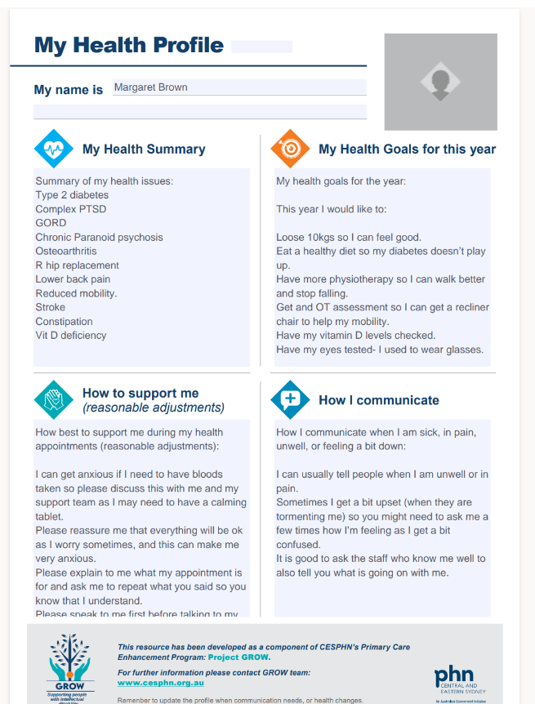
My Health Profile
SAMPLE
My health profile- this includes reasonable adjustments person may need.
What do you think might be your role in conveying reasonable adjustments.
Notes:
What is the role of the support worker in conveying reasonable adjustments?
The support worker has a pivotal role in practices understanding and taking up these accommodations seriously.
Their role is not just to understand the intricacies of the necessary adjustments but how to relay there importance to the health professionals.
The impact of how the information is shared can influence how the health professional will respond. If the supporter is curt or doesn’t take the adjustments seriously the health professional might have a negative reaction or not understand the importance of them.
The support worker is responsible for conveying the adjustments in a way that evokes a positive response and action.
Activity
Hand out One-page profiles/reasonable adjustment plan
Fill in the page and include some reasonable adjustments. These can be made up or actual adjustments you need.
Only the two segments.
Find 2 other people in the group you don’t know and partner with them. !!Do not discus your adjustments
There are 3 roles, patient, Dr and support worker. Choose which role each of you will have
Hand over your profile.
Questions:
How did you feel as the patient? (Was the language supportive or apologetic?)
Did you feel they understood your needs
Is it important to have prior knowledge of a person? And not just their file.
How was it for the GP?
REMINDER: CID info calls from parents.

Slide 45

SGH Disability Inclusion Committee
- Patient Story -

Slide 46
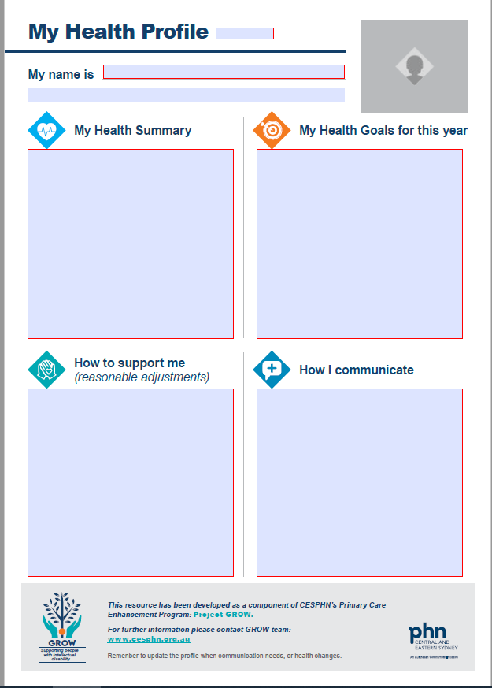

Slide 47

Background…
59yo person living in supported accommodation:
  Moderate-severe ID
  Major depressive disorder
  Anxiety
Difficult engagement due to behaviours
  Biting, banging, throwing items in reach
Required colonoscopy
Notes:
Has a history of chewing/swallowing difficulties
Has a restraint protocol used at the group home
Dynamic behaviour – risk with minimal warning

Slide 48
Pre-planning…
Received hospital care plan from the group home which included My Health Profile
  Included communication style, care requirements, behaviours, personal preferences
Admission 2 Discharge Together (A2DT) tool completed, identified:
  At risk of displaying challenging behaviours
  Diversion and reassurance required
  Limited, repetitive verbal communication
Stakeholder meeting to prepare for admission, including reps from all disciplines and group home
Devised care plan of patient needs and resources required
Notes:
Pre planning: meeting minimum 48hrs in advance to identify and implement strategies
Key reps: anaesthetics, NUMs, CSMs, day surgery, num of ward, group home, transition team, SIDHT, patient flow CNC
Everyone had roles and responsibilities either before or during admission

Slide 49
On the day…
Psychiatrist prescribed Clonidine – given before coming in for procedure
Used a car park out the back of the hospital for a less stimulating environment
Patient was more comfortable being around males
2 x males greeted patient with a coffee and toys to celebrate her recent birthday and to remove the anxiety of being in an unfamiliar environment.
Transported up to 3 South using uncrowded access
Set her room up for her birthday including more toys/games
Arranged carer comforts including recliner chair, hospital meals
MDT arranged a change in theatre time, pt placed first on the list
Notes:
Psychiatrist prescribed Clonadine – given before coming in for procedure
Let the carer use a car park out the back of JLH so it didn’t look like patient was coming to hospital
Patient was more comfortable being around males
Blake and Gavin met he rout the back, coffee and teddies (likes) – birthday, Shannan and Kerrie hiding in bushes in case help was needed
Strategic and creative
2x males Greeted patient with a coffee and toys to celebrate her recent birthday and to remove the anxiety of being in an unfamiliar environment.
Transported her up to 3 south using uncrowded access
Distraction and diversion techniques, removed the clinical feel, NUM put fairy lights in her office – view from pts room
Set her room up for her birthday including more toys from 1E
Arranged carer comforts including recliner chair, hospital meals,
MDT arranged change in theatre time, pt placed first on the list
Anaesthetics rearranged list and put her first

Slide 50
Lessons…
Getting to know her likes, dislikes and fears helped a successful admission and discharge
MDT approach– not doing it in silos
Thinking outside the square – be creative i.e. entrance into hospital
Discharged straight from recovery = shorter admission due to good pre-planning
Having pre-admission staff flag early gave time to plan

Slide 51
How Someone with an Intellectual Disability May Present When Experiencing a Mental Health Problem
Recognising the Signs and Supporting Early Intervention

Slide 52
Common Mental Health Issues & Barriers
Key Points:
People with ID have higher rates of:
  Anxiety
  Depression
  Psychosis
  PTSD
  OCD
Barriers to recognition:
  Diagnostic overshadowing (attributing symptoms to ID)
  Limited self-reporting
  Misinterpreted behaviours
  Limited social supports/isolation

Slide 53
Signs to Look For
Behavioural:
Aggression, self-injury, withdrawal, sleep/appetite changes, sexualised behaviours
Emotional:
Tearfulness, irritability, fearfulness, mood swings
Cognitive/Communication:
Confusion, regression, increased repetition, talking to self
Physical:
Headaches, fatigue, nausea without clear medical cause

Slide 54
Responding to Concerns
Be proactive!
Observe and document changes clearly
Communicate with family/carers
Seek specialist input (GP, psychiatry, psychology, OT, BSP)
Support communication needs
Develop a safety plan if risk is identified

Slide 55
Risk Indicators & Importance of Baseline
Serious Signs:
Expressions of hopelessness, suicidal thoughts, severe withdrawal
Escalation in aggressive/self-harm behaviours
Baseline Knowledge:
Know what’s normal for the individual
Small changes can be significant

Slide 56
Behaviours of Concern vs Mental Health Disorders
Behaviours of concern do not always indicate a mental health disorder.
Changes in behaviour may be due to environmental, physical health, communication difficulties, or sensory factors.
A functional and behavioural assessment must be completed to explore the cause of behaviours.
Understanding an individual's baseline functioning is essential to accurately identify changes that might suggest mental health issues.

Slide 57
What is an Annual Health Assessment
The health assessment is the primary source of health information the GP uses to guide the person and their support team on person’s health goals for the year. The annual health assessment aim:
Gather information about the person’s current and long-term health needs
Identify health risks/ record diagnoses
Record actions and treatment to manage current and chronic health conditions
Monitor a person’s medication
Discuss preventative health care actions (e.g. diet plan, vaccines, screening)
Develop an annual healthcare plan in consultation with the person and their support team
Provide a financial incentive to the GP with its completion.
Notes:
Jen.
Discuss this slide briefly what skills are the core skills in developing this annual health assessment and gathering, using the checklist to review the overall health issues, completing a risk review, recording actions, monitoring change, develop preventative strategies and developing the plan with the person.
Whose responsibility is this to support this assessment being completed. A health check is a way to address reviewing the persons current health symptoms, chronic disease management and preventative health issues.

Slide 58
Annual Health Assessments
Group discussion with Dr. Jess Murphy
What are the current issues/challenges/barriers with annual health assessment process for the people you support?
Notes:
Group work – Someone to theme the responses under Week 1, Week 2, Week 3, and Week 4 for the end of the session to ask whether we have answered their concerns.
7 minutes to discuss
7 minutes to scribe on whiteboard

Slide 59

Annual Health Assessments Tools
CHAP Tool
Medicare Department of Health Annual
Health Assessment
GPs or SIL providers may have developed their own templates
Are you keen to better understand
Annual Health Assessments
Notes:
Practice software templates – if your organisation doesn’t specify which template to use, ask the GP which template they prefer
All have a similar structure, fill out the first section prior to the appointment.

Slide 60
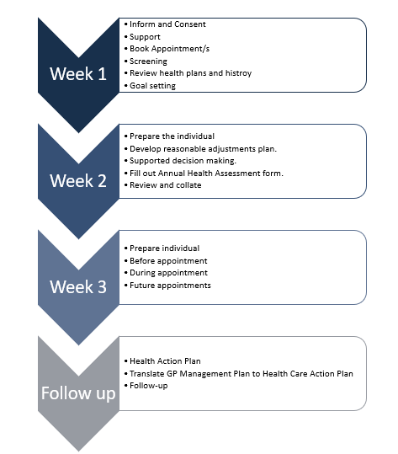
Introducing the Annual Health Assessment Process
Notes:
Jen
An Annual Health Assessment (AHA) is an opportunity to reflect on an individual’s past, current and future health to create a plan and goals for the year ahead.
Why is an AHA process important for people in Supported Independent Living (SIL) accommodation?
Potentially avoidable hospitalisations occur up to 8 times higher for people with intellectual disability. These events are stressful and costly for the individual and the people that support them.
SIL participants rely on support staff to coordinate care, observe changes, and enact health measures (immunisation, medication reviews, and cancer screening etc.)
A proactive process is more likely to catch health issues earlier, especially when there are communication barriers.
This process is designed to:
Produce proactive ‘living’ health plans that reduce reactive health care and hospitalisations.
Encourage people to be actively involved with their GP in planning and actioning annual health goals.
Increase confidence of SIL staff to promote and support proactive health care.
Increase support staff’s understanding of how primary health care functions to foster better communication and interactions with GP practices.
The annual health assessment is a tool which summarises information about the patients past history and guides the GP through health assessment, highlighting commonly overlooked , difficult to manage or syndrome specific health conditions for patients with an intellectual disability.

Slide 61
Annual Health Process
  Inform and Consent
  Support
  Book Appointment/s
  Screening
  Review health plans and history
  Goal setting
Week 1
Notes:
Inform and Consent
Using Page 3 to discuss what is the AHA and why it is important to conduct one
Consent for the person and ensure they know what they will be consenting to ( use of their private information for purpose of completing a AHA)
Support
provision of simple language resources which can be used to help person understand the importance of the AHA
Support
Choosing a person who has good Repour with the person and Know the persons health and communication styles and discussion about what the person would like support with.
Question to the person about whether they want you be with them in the room or when and what they would like support for during the consultation.
Book appointment
Its important to chose a GP who you know and have good rapport with . It is important to have a good relationship with the GP and the practice
Assist the person to make the GP appointment
Booking a telehealth appointment with the GP 2-3 weeks out will help with screening or blood tests required and provide opportunity to flag the reasonable adjustments
Annual Health assessments
Best practice is to inform reception you are booking the AHA for some one with ID and will need the long app 45-60 min or prolonged 60 minutes to ensure there is enough time for app. You can enquire for the app to be broken into 2or 3 separate visits but it is important to schedule a time you know works best for the person
Screening
Organize screening or blood test that may be requested by Gp prior to appointment and ensure reasonable adjustments are applied to support these interventions
Review
Gather the information from relevant parties and ensure that you organise these opportunities well in advance
Consider consulting with the family, friends, key workers, allied health and all those known to the person to get the best collection of information
Goal Setting
Prepare the health goals important to the person and consider all of their health issues around mobility, nutrition and swallowing, medication etc
Those goals may be about how they can improve mobility, increase choices with health lifestyle activities, managing their diabetes or increasing their social activities to improve mental health

Slide 62
Annual Health Process
  Prepare the individual
  Develop reasonable adjustments plan.
  Supported decision making.
  Fill out Annual Health Assessment form.
  Review and collate
Week 2
Notes:
Preparing the person
Being aware of the persons challenges or triggers they may encounter and supporting them to have a better understanding of what will take place at the appointment
What tools can you use to assist them to know what is going to happen, do they have questions or concerns and do they need a communication device in the appointment
Reasonable adjustments
Developing a plan for each reasonable adjustment like scheduling appointments during the quieter times, call practice to check if on time, wait in the care and ask reception to call when GP is ready
Communicate those relevant changes in advance helps the practice and the person to adjust to the challenges posed by the environment
Supported Decision making
Understand what is the capacity of the person to make decisions and when to engage their guardian and ensuring that the guardian or person responsible is around at time of appointment
Filling out AHA form
This is the time to fill out the first section of the assessment and review the persons health needs over the last year and if there are other sources that needs to be contacted to get the relevant information
Review and collate
Engage with people who are know to them personally and professionally and decide which allied health or specialist reports might be useful for the appointment
Review goals from the previous plans, review unplanned hospitalizations, medication changes, critical incidents and handover notes which reflect changes in behavior or health

Slide 63
Annual Health Process
  Prepare individual
  Before appointment
  During appointment
  Future appointments
Week 3
Notes:
Prepare
Collate all the necessary documents prepared in the previous weeks and bring prepopulated annual health assessment tool, the reasonable adjustments plan, previous health plan, specialist reports, goals for the coming year
Before appointment
On day of appointment call the GP practice to remind them of the appointment and RA they have agreed to provide
Be aware you may need to explain these again as you can not expect staff in practice to remember these for that person
Remind the person and walk them through the appointment with tools required
During appointment
Follow the RA plan and confirm the individual is ok with the staff member accompanying them into the room with the GP
Remind them that they can be asked by the person to leave at any time and remind the practice staff on how best to support and communicate with the person during the examination
Contact the person responsible for making medical decisions
Future appointment
Discuss the next appointment with the GP before you leave the visit and the type of appointment and what will be the priorities i.e Actioning the health care goals which may be referred to as the GP management plan
Signing of support plans

Slide 64
Annual Health Process
  Health Action Plan
  Translate GP Management Plan to Health Care Action Plan
  Follow-up
Follow up
Notes:
Health Action plan
Refer to the individuals goals developed with the GP, and ensuring each goal has achievable actions with realistic time frames
Consider who needs to be aware of the person health priorities for th year ahead such as specialist, allied health, family and carers
Discuss roles and responsibilities for actions and how the support network can collaborate throughout the year
Translate GP management plan to health care action plan
The Gp management plan defines clear health goals and actions that align with the SIL health action plan
Copy the prioritized goals and actions from the GP management plan into the SIL client management system.
Follow up
Discuss persons goals and health plan at team meetings
Follow up on referrals
Attend GP appointments
Monitor and make note of any changes when new medication is prescribed for side effects and report bac to GP

Slide 65
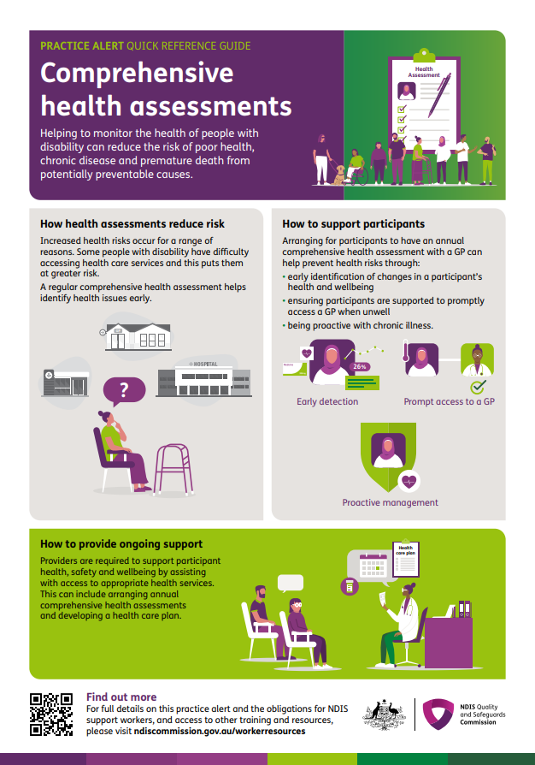
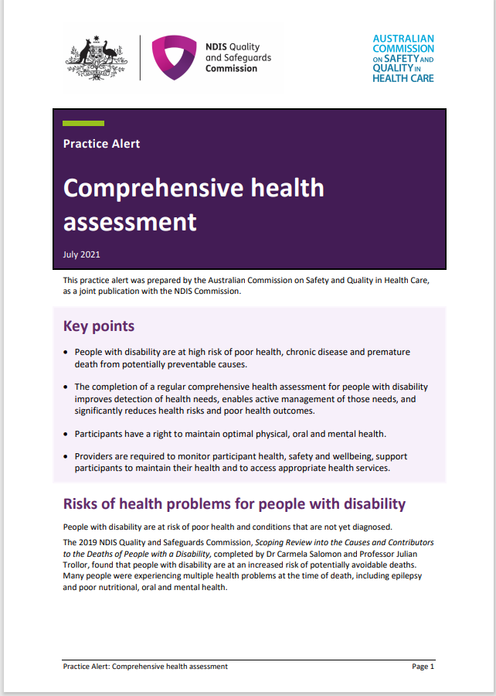
NDIS Practice Alert for health assessments
Refer to the website for the full document
https://www.ndiscommission.gov.au/workerresources

Slide 66
AHA Activity
Please read Charlie’s Story
Do
Group 1: What do you need to do in Week 1 and what else do you think about .
Do
Group 2: What do you need to do in Week 2 and what else do you think about or do.
Do
Group 3: What do you need to do in Week 3 &4 and what else do you think about or do
Develop
Group 4: Develop the person’s 1 page health profile
Do
Present
Each Group will present to the rest of the team
Group 5: identify any other issues that may not have been addressed in the process that could potentially impact the person’s overall wellbeing.

Slide 67
Top 5 tips to improve the annual health assessment
Involve the person and the people who know them well when collecting information and preparing documentation.
Be prepared: use the checklist and start the assessment process at least three weeks before the appointment - longer if the individual has complex needs.
Be clear what reasonable adjustments are needed if the person is known to get upset due to medical triggers, past trauma, challenging behaviours etc.
Alert the GP and the GP practice about any reasonable adjustments needed. This will insure the person has a reasonably positive experience.
Understand the different types of appointments a GP can bill for. Use telehealth when possible and ask for the AHA appointment to be split over a few appointments if best for the individual.
Notes:
To finish:

Slide 68


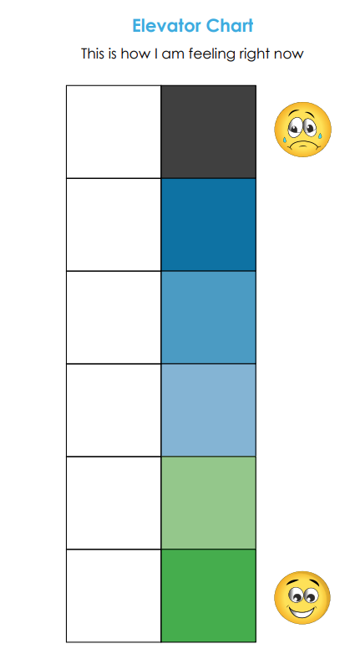

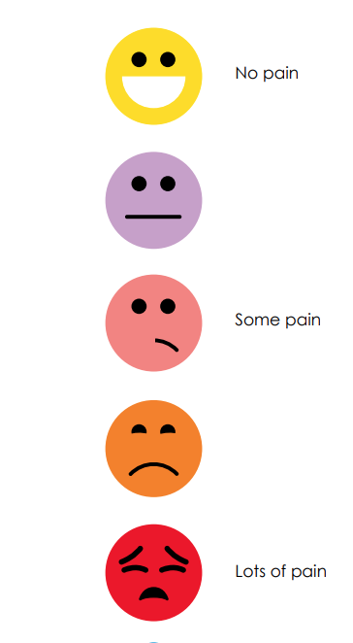

Communication Resources
End of life tool kit
My Health Matters folder
Admission to Discharge (A2D)
Say Less, Show More

Slide 69
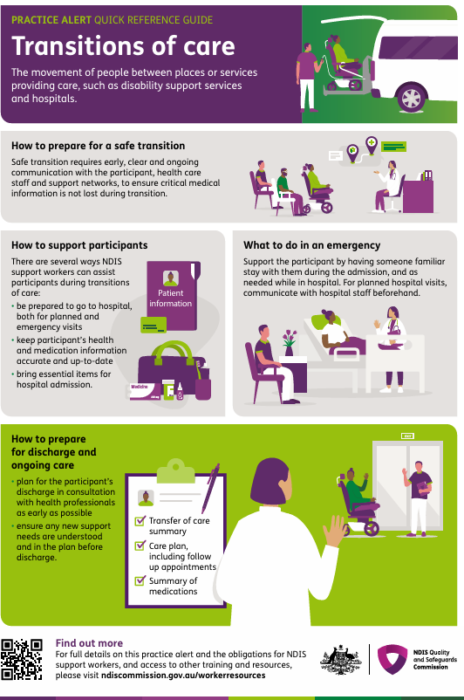
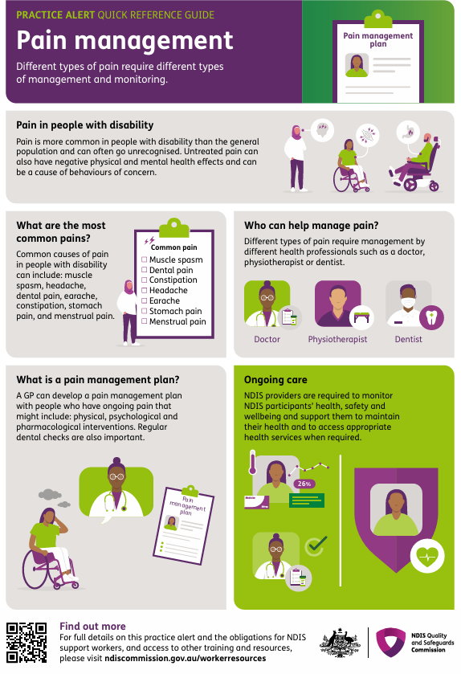
2 new Practice Alerts

Slide 70
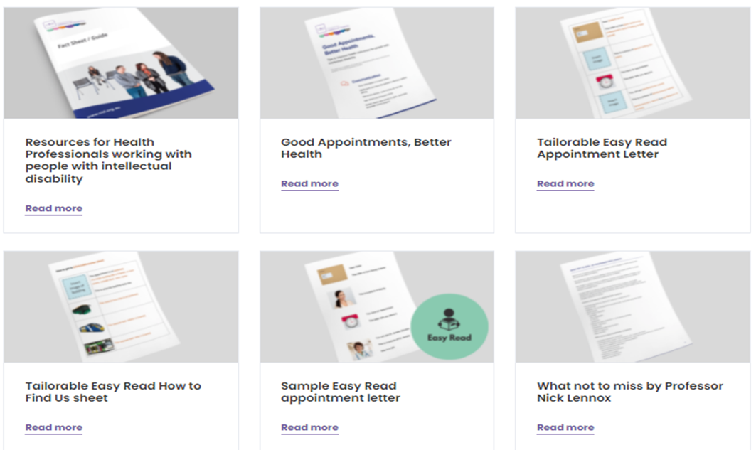
Resources for Health Professionals working with people with intellectual disability
cid.org.au/health/resources-health-professionals/

Slide 71
Feedback from the AHA Activity
What did you learn by doing this activity together?
Did you find this activity helpful?
What will you do differently when you go back to your workplace?

Slide 72
Lunch
Notes:
(30 minutes)

Slide 73


Intellectual Disability Health Service
South Eastern Sydney Local Health District

Slide 74

Who are we?
We are a multidisciplinary team, consisting of
  Team Leader & Clinical Nurse Consultant Gavin Begbie
  Social Worker – Michael Morgan
  MHID clinician - Vacant
  Psychiatrist – Dr Keller
  Rehabilitation physician – Dr Taskin
  Developmental Paediatrician – Dr Piper
  Child and Adolescent psychiatrist – Dr Bickerton

Slide 75

Where do we sit?
Developmental Disability Health Service
Specialised Intellectual DisabilityHealth Team
(Formerly MRID)
Developmental Disability Assessment Team DDAT
(Formerly Kogarah DAS)
Supports Sutherland and St George Region
Supports South Eastern Sydney LHD, Illawarra Shoalhaven LHD and Napean Blue Mountains LHD
Provides local ID diagnostic and subspecialty local services
Offers comprehensive assessment and time limited interventions (12 months) for clients with an ID
Notes:
Our SIDHT team cover a large area – SESLHD, Illawarra and NBM
However the majority of our current clients are SESLHD.

Slide 76

What is our Role?
Clinical assessment/development comprehensive case management plans
  People with an Intellectual Disability and complex unmet health needs
Capacity Building
  Hospital, community health and primary health professionals
Reporting and accountability
Multidisciplinary teams
Notes:
Our roles is 3 fold – we complete assessments and make recommendations.
We support people who work with people with an ID as able to better understand the health needs and reasonable adjustments that may need to be required when working with a person their family, carers and/or health professionals.
In general Mum and dad know best and will guide most processes.
We need to collect the data and information – part of the reason this is important is to continue to shine a light on the needs for people with an ID. Obviously also funding etc.
The key to our team is that it is multidisciplinary with an aim to ensure there is a wholistic approach taken when working wit someone with an ID.

Slide 77

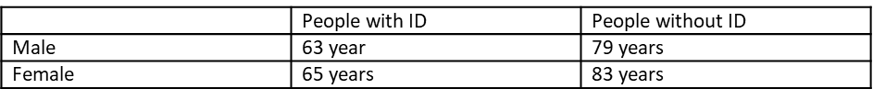
Why is there a need for the team?
People with intellectual disability have a higher prevalence of physical and psychiatric conditions, higher levels of morbidity and experience poorer health outcomes than the general population.
Life expectancy is significantly reduced for people with Intellectual Disability as detailed below (2010)
People with Intellectual Disabilities experience significant health inequalities compared with the general population

Slide 78

Important points
Client must have an Intellectual Disability
Client must have a current unresolved health concern
Complex health conditions
Time limited – short recommendation based service
Within the correct geographical region

Slide 79

Referral process!
Community Referrals
  Contact SIDHT office (phone or email)
  Complete referral form or provide GP referral
  Once returned referral will be triaged
In-Patients referrals
  Contact SIDHT office (phone or email)

Slide 80

How to contact us?
We are based at Burbangana, 2 Belgrave St, Kogarah
Email: SESLHD-SIDHT@health.nsw.gov.au
Phone Number: 8566 1222 (DDHS reception)

Slide 81
Specialist Team for Intellectual Disability Sydney (STrIDeS)
Kim Bonnici, Social Worker
Specialist Team for Intellectual Disability (STrIDeS)
Sydney Local Health District (SLHD)

Slide 82
Who are STrIDeS
One of 7 specialist health teams in NSW for people with intellectual disability
STrIDeS team:
    Developmental paediatrician (Dr Jacqueline Small)
    Adult physician (Dr Alexis Berry)
    Clinical Nurse Consultant (currently vacant)
    Social Worker (Kim Bonnici)
    Program manager (Meagan Dyson)

Slide 83
What STrIDeS can do
Case consultation and advice
With a medical referral
  Comprehensive multi-disciplinary health assessment and report with recommendations
  Case discussions with stakeholders (family, health services, disability support services etc)
  Short-term support to implement recommendations

Slide 84
When to refer to STrIDeS
Support staff/family identify a health issue – e.g. changes in weight/sleep/appetite/change in bowels (eg constipation), changes in functioning, changes in behaviour, more falls
GP – first point of call
When things don’t improve or there are barriers to accessing care or GP requests – consider referral to STrIDeS
Consultation can be provided eg hospital admission

Slide 85
What will help STrIDeS to provide support recommendations?
Things that help our team to assess and provide recommendations:
    CHAP
    weight charts
    bowel charts
    previous reports
    identifying the decision maker (client/substitute decision maker – person responsible/legal guardian)
    reasonable adjustment needs
    support person at appointment that knows client well and can provide health information

Slide 86
SLHD Disability Teams
  STrIDeS (Specialist Team for Intellectual Disability Sydney) 9378 1364 or SLHD-STRIDES@health.nsw.gov.au
  DARTYP (Disability Assessment and Rehabilitation Team for Young People) 9767 5730 or SLHD-DARTYP@health.nsw.gov.au
  Intellectual Disability Adult Mental Health Service 9767 5730 SLHD-IDMHS@health.nsw.gov.au

Slide 87

Questions
This Photo by Unknown Author is licensed under CC BY-NC

Slide 88
How to work collaboratively with GPs
Dr Jessica Murphy

Slide 89
First Steps
Foster a relationship with the GP
Introduce yourself to them as SIL team leader & to key contacts at your facility who they can contact
Let them know the best contact method for you/your facility
Ask the GP to introduce you to their key contacts – practice manager/key admin person
Ask how they would best like to be contacted with info – phone/email/fax

Slide 90
Booking Appointments
Discuss with the GP/practice how best to book in appointments
Particular time/day?
Take into account reasonable adjustments needed for the patient
Online/phone/via key contact person
Also discuss how to organise recalls/reminders
Who will they be sent to?
What format works best for the patient?
Need to ensure patient consent documented!
Notes:
Quiet times/wait rooms
Can’t expect all to be fulfilled – need to understand GP perspective re what can accommodate

Slide 91
Preparing for Appointments
Ensure you alert staff/GP in advance of reasonable adjustments needed – again how would they like this information? Who best to communicate to at the practice re this? May need to re-send this information
Provide My Health Profile in advance & ensure this kept up to date – living document
Discuss as a team before the appointment what are your agendas/needs for the patient? What are the patient’s needs? Family requests
Notes:
It is your responsibility as SIL’s providers to advocate for the patient – need to let us know how to help/do reasonable adjustments
Our responsibility to follow this & provide them but we can’t be relied upon to remember/organise every time as may not be done!!
DO need to re-send it

Slide 92
During Appointments
GP agenda vs your & patients’ agenda
Vital to send somebody with the patient who knows their needs, background & issues to be discussed
Please understand there is limited time – most standard appointments are only set for 10-15 minutes
We can’t sign/discuss paperwork & deal with medical problems all in one consult – try to organise this for a separate appointment if possible or book a long appointment
Appointments don’t always run on time – if the patient is becoming distressed in the waiting room please alert someone – a decision can then be made how to handle it
Notes:
Your agenda – filled in on the health profile
Example of GP registrar – new pt, 15 mins appt, 7 forms – not familiar with pt, not familiar with forms – puts them off doing this care
Patient Safety & medicolegal responsibilities
People don’t die because a form isn’t signed

Slide 93
You are the advocate for the patient!
Notes:
If you feel something is not being done/you are not being listened to or something is not right – please speak up!!
We are human too – we miss things, make mistakes & need to be kept in check!
Sadly not all doctors are going to want to invest as much time as others – if not getting the right service then please consider is this right for your patient?
If the patient isn’t comfortable during appointments then have discussion with them/family/as a team ? Change GP

Slide 94
After the appointment
Ensure information re management plans effectively communicated & documented
Ensure plans kept up to date – living document
Ensure follow up appointments booked in advance – always plan opportunity for review
Notes:
Will give you some examples later of how to actually make things a living document

Slide 95
Q&A
Notes:
Is there any comments/things you want to troubleshoot

Slide 96
Understanding Appointment Types, Medicare & Billing
Notes:
Want to help you to understand why booking the right type of appointment is important for your patient but also for the GP

Slide 97
A bit of context…
GPs are under a lot of pressure
Want to support patients but time is limited!!
Medicare billing is restrictive & doesn’t support providing complex care
Only get paid for consultation time – Additional admin is done without pay!
Notes:
Already touched earlier upon patient safety & medicolegal issues but now want to go more into medicare rebates
Health is becoming more complex – aging population, complex mental health issues, trying to keep people out of hospital/ED
Way system is funded is a big barrier to proper care for these patients
For some GPs they feel the time they need to spend with complex patients simply isn’t worth it
Female GPs are disadvantaged – women’s health, mental health
E.G. I spend 19 mins with a patient to deal with 3 issues. My male colleague spends 6 mins with a patient. He’s seen 3 patients in that time & earned 3x more than me
How can you help your GP AND your patient?
Planning & being pro-active can help with this - break down the appointments into chunks – repeated visits with smaller problems vs taking 30 mins & trying to squeeze it all in

Slide 98
NDIS requirements not always understood by GPs
Additional administrative burden
GPs can sometimes feel they are being made to do additional “free work” on behalf of others
Notes:
Eg. Restrictive practices

Slide 99
Appointment Types
General Consults
Standard appointment is 10-15 mins – only really suitable for straightforward or minor problems
Likely best to always book a long consultation for these patients
Telehealth
Ideal to be used for simple things in between consults
Repeat Scripts
Signing forms (can be sent via fax/email then returned)
Notes:
Please refer to document re appointment types
You don’t need to remember the numbers or fees – just to give you some insight!
As discussed, due to safety, medicolegal & financial reasons …
Takes the pressure off the GP, stops them running late – likely to listen more & be more thorough
GPs may not be aware of how to make it effective for them – Signpost to project GROW

Slide 100
Annual Health Assessments
Billed depending on time spent with the patient as a whole
This can be done over several appointments & parts can be done with the nurse
Makes it easier for the GP
Think about your patient – what works best for them?

Slide 101
GP Chronic Condition Management Plan (GPCCMP)
What is a GP Management Plan?
For patients with chronic medical conditions (present >6m)
Opportunity to review & co-ordinate care for next 12 months – what are the needs/goals for the patient?
Can also use to refer to allied health professionals
Allows up to 5 visits per calendar year with a Medicare rebate
The plans can be reviewed on a 3-6 monthly basis (depending on complexity)
Opportunity to review if goals are being achieved & what else needs to be done?
Notes:
See attached example GPMP/TCA
Can use the GPMP instead of your traditional health plan that you’re used to do (instead of duplicating)
This is how it becomes a living document
Gives responsibility back onto GP re ongoing healthcare/prevention
How regular appointments for reviews help – becomes less complex over time once on top of all these problems – don’t let the problems build up then come in all at once – very hard
**** Due to change July – GPMP & TCA will be one item instead of two – unsure if going to change reviews

Slide 102
Case Conference
Complex medical issues
Can be organised by the GP or by another health professional – you can organise!
Billed per time spent on the case conference (Allied health can bill medicare too for this)
GPs may not be aware of this as an option

Slide 103
Continuity of Care
Stick to one regular GP for review appointments – Health assessments, GP Management plans, medication reviews
If that GP is away on leave then best to defer it until they’re back – ensures continuity of care
Acute problems with any available GP

Slide 104
Thank you for listening to the GP perspective!
Any Questions/Comments?

Slide 105
Break
Notes:
(15 minutes)

Slide 106


Intellectual Disability Palliative Care
Maria Heaton
SESLHD Intellectual Disability Palliative Care Clinical Nurse Consultant

Slide 107

ATTENTION!
This content is sensitive and emotional.
The intention is not to upset anyone but to provide information.
Please feel free to step outside if you are finding it difficult and seek support from your manager.

Slide 108


Slide 109
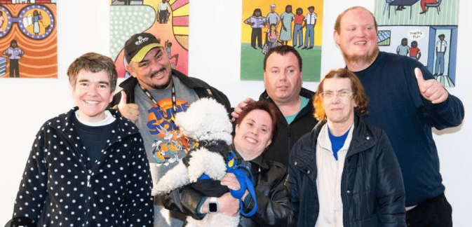
Acknowledgement of Lived Experience
I would like to acknowledge people with lived experience of intellectual disability and the carers who support them.

Slide 110
What is Palliative Care
Palliative care is an approach that improves the quality of life of patients (adults and children) and their families who are facing problems associated with life-threatening illness.
It prevents and relieves suffering through the early identification, correct assessment and treatment of pain and other problems, whether physical, psychosocial or spiritual. (WHO, 2002)
Notes:
Palliative Care can get involed in your care at any stage of your illness. It does not mean that you are imminently dying.
Palliative care is not just for people who have advanced cancer. It can also be provided to be people with (but not limited to) end stage heart, lung or kidney disease, neurological conditions and end stage dementia.
The way palliative care is provided and who provides it depends on the person’s needs. As the person’s condition starts to change and their needs increase, the earlier a person can receive a palliative care approach to their care, the better their quality of life and symptoms may be.

Slide 111
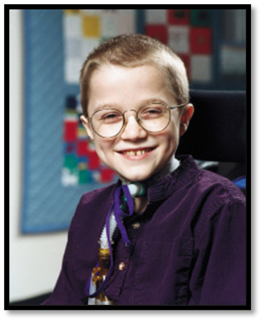

What is Palliative Care
“Palliative Care no longer means helping people
die well, it means helping people and their
families live well and then when the time is
certain, helping them to die gently”
Mattie Stepanek (1990-2007)
Notes:
Palliative Care can get involed in your care at any stage of your illness. It does not mean that you are imminently dying.
Palliative care is not just for people who have advanced cancer. It can also be provided to be people with (but not limited to) end stage heart, lung or kidney disease, neurological conditions and end stage dementia.
The way palliative care is provided and who provides it depends on the person’s needs. As the person’s condition starts to change and their needs increase, the earlier a person can receive a palliative care approach to their care, the better their quality of life and symptoms may be.

Slide 112
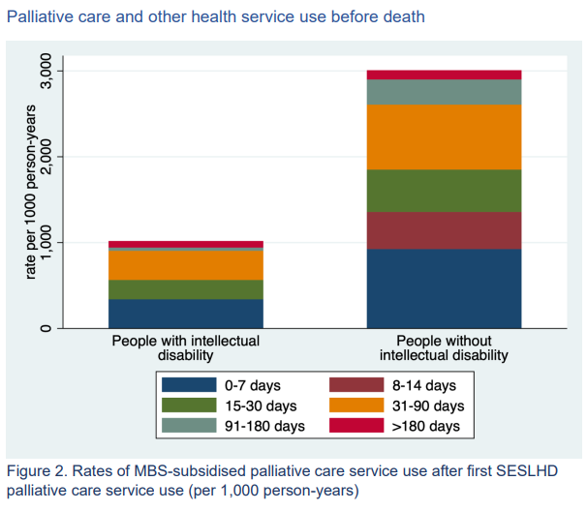
SESLHD Palliative Care Use Before Death
Notes:
MBS data was utilised to demonstrate that within SESLHD only 30% of people with ID who died between 2001 and 2018 had accessed palliative care services.

Slide 113
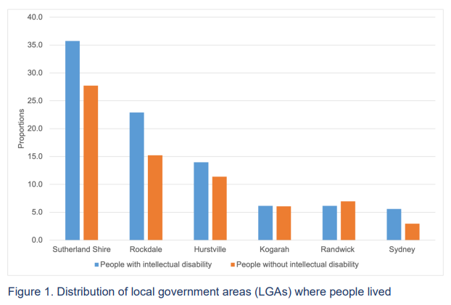
Location of People with Intellectual Disability in SESLHD
2001-2018
Notes:
UNSW collaborated with SESLHD to gather and analyse data specific to our district.
Distribution by LGA of people with intellectual disability:
Sutherland Shire and Georges River (Sutherland Hospital Area) – 49.72% more than 50%
Bayside Council (St George Hospital Area) – 29.06%
Randwick and Sydney City Council (POWH Area) – 11.74%
Service Utilization Before Death:
- Lower rates of MBS-subsidized palliative care services for those with vs without intellectual disability.
- Higher rates of palliative care admissions for those with intellectual disability.
- Higher ED presentation rates in the last 30 days for those with intellectual disability.
- More medicines for epilepsy but fewer for pain management in those with intellectual disability.

Slide 114
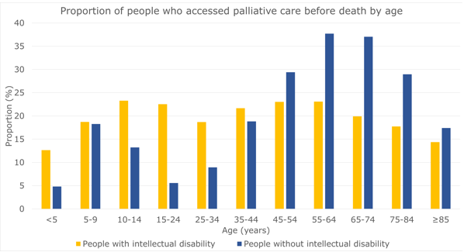
Data regarding Palliative Care use by age
Cvejic R, Srasuebkul P, Vajdic C et al, 2023, Palliative care use by people with intellectual disability: A linked data study in NSW, Australia. UNSW.
Notes:
Overall, fewer people with intellectual disability had any record of palliative care use (20% of all deaths, 53% of deaths from cancer) than people without intellectual disability (27% of all deaths, 63% of deaths from cancer), but this differed by age at death.
The proportions of people who accessed palliative care were higher among younger people with intellectual disability (13-23% across 5-year age-bands from 0-44 years) than in younger people without intellectual disability (5-19%). However, access to palliative care was lower for older people with intellectual disability (14-23% across 5-year age-bands from 45-≥85 years) than older people without intellectual disability (17-37%).
I think that this could be because younger people tend to have more family involved and therefore more advocacy.

Slide 115

Changes as a person’s health deteriorates
Oral intake
Output
Tiredness
Drowsiness
Oral hygiene
Pain

Slide 116

Quality of Life
  Physical – How does the person feel? How independent and active are they?
  Emotional – How happy they are? Do they feel valued and respected?
  Social – Are they seeing the important people in their lives regularly? Do they feel valued by these people?
  Spiritual (not religious) – Do they feel connected to or a part of something bigger that adds value to their life?

Slide 117

When is the right time?
Palliative care is best introduced at time of diagnosis of a life limiting condition.
Palliative care can be provided alongside curative treatment.

Slide 118
How to decide if a client will benefit from palliative care?
Will you be surprised if they died in the next two years?
Has there been permanent functional decline?
Are the treatments being done to the person rather than for the person?
What are their/their family’s wishes?

Slide 119
SESLHD Palliative Care Services
SESLHD District palliative Care Team
POWH
Inpatient
Community
SGH
Inpatient
TSH
Inpatient
Outpatient
Outpatient
Outpatient
There are also condition specific supportive palliative care clinics such as Cardiac, Renal and Respiratory
Calvary Health Care Kogarah

Slide 120
Community Supportive Care Clinic
Must have at least one of the following general triggers:
  Complex and increasing symptom burden
  Persistent symptoms, despite optimal treatment of underlying condition(s)
  Deterioration in functional performance status and increased support needs
  Patient requires advance care planning
  Progressive weight loss of more than 10% dry body mass, in last 6 months
  Two or more unplanned acute admissions in the last 12 months
  Patient or family requesting supportive and/or palliative care input
The client must be able to attend the clinic at least for the first visit. Follow up can be done via telehealth or a home visit.

Slide 121

REFLECTIVE EXERCISE – DEATH & DYING
Personal Values, Views, and Attitudes

Slide 122

What does death mean to you?

Slide 123

What was your first ever experience of death? How did you feel? What memories do you have of this experience?

Slide 124

Have you experienced the death of someone close to you? How did it affect you?

Slide 125

How does you culture or religion shape your understanding of death?

Slide 126

Are you comfortable talking about death with others? Why and why not?

Slide 127

What rituals or traditions around dying do you find meaningful or comforting?

Slide 128

Questions?
GRIEFLINE 1300 845 745
8AM-8PM 7 Days

Slide 129
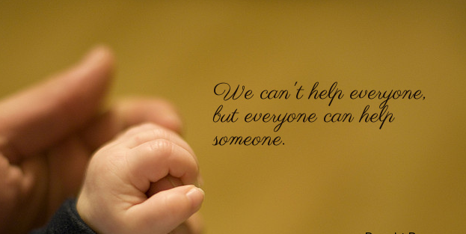
Maria Heaton
Phone: 0461517088
Email:
seslhd-intellectual-disability-palliativecare@health.nsw.gov.au

Slide 130
Q&A Session
Notes:
With GROW team and Jess
Post it notes on the whiteboard

Slide 131

Notes:
Hannah – Project GROW promotion

Slide 132
Project GROW
Navigation
Education
Advocacy
Training in general practices
GROW Service Navigators are available for ongoing support, referral pathways.
SIL provider training
We will hold more workshops next year.
If you have colleagues who may be interested, please contact our team at intellectualdisability@cesphn.com.au.
Notes:
Seeking support with promotion, offer to your practices – we’re working to improve the knowledge and processes on our end, CESPHN’s GROW can support practice.
Resource at the front of your folders about how to contact GROW. Business cards/flyers in the envelopes, implore people to pass on to GPs or primary care clinicians who are supporting your clients. Allied health, GPs, administration staff etc. Tailored training.
Resources in your folders are in draft form. We are eager to hear feedback on these as you go along, are they useful, are they useless, has anything been overlooked etc. We really appreciate your feedback.
To further support the implementation of the process, we’ll also host bi-monthly community of practice sessions. These will be online, with Catherine hosting these (and ?jess in attendance), come along with your questions etc.

Slide 133
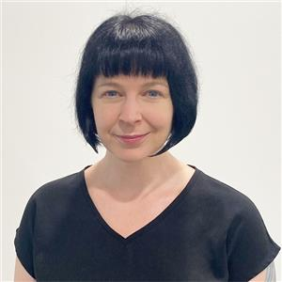
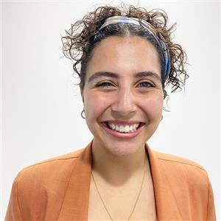
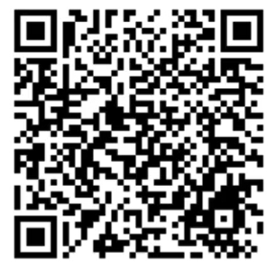
GROW Educators and Service Navigators
For more information about GROW visit, our Website:
https://www.cesphn.org.au/general-practice/help-my-patients-with/intellectual-disability
Naomi Halligan
9304 8640
Dominique Abagi
9304 8739
intellectualdisability@cesphn.com.au

Slide 134

CESPHN Disability Network
The Network is a collaborative forum of representatives from across the disability and health sectors.
Our goal is to build connection between the sectors and support more integrated, inclusive approaches to care and support.
To join or find out more email, disability@cesphn.com.au

Slide 135
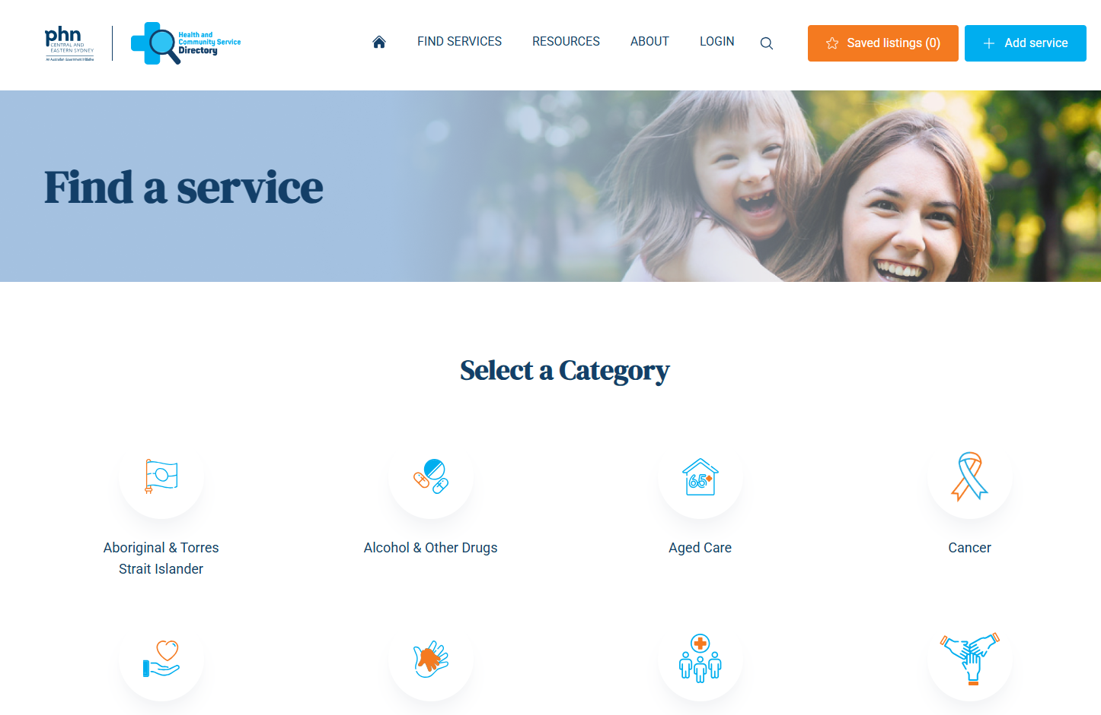
Community Service Directory
The purpose of the directory is to help people better understand what local health services are available to them.
To add your service to the directory or find out more, visit https://servicedirectory.cesphn.org.au/

Slide 136
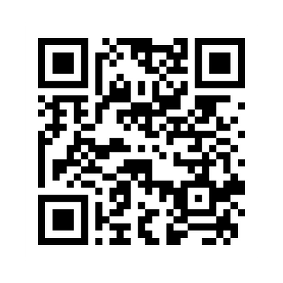
Evaluation Survey: please complete via the QR Code
Notes:
Palliative care initiative – extend training to Disability Sector
Send feedback back to your organisations and up through management -5 minutes
Really valuable information.

Slide 137
Your feedback to us
Thank you so much for your time today
Thank you for all you do for the people you support
What you do every day in your work can make a positive difference
Before you go, we have a few questions
Notes:
Wrap up.

Slide 138

Do you have a better understanding of:
What preventive healthcare is and the importance of the Annual Health Assessments.
Your role, along with the roles and responsibilities of the person and their support team, to keep them healthy and well.
Notes:
GROW team take notes!

Slide 139
Do you feel more confident to:
Implement the annual health assessment process and develop a one- page health profile that includes what reasonable adjustments the person may need.
Work in partnership with the person’s GP and their family and foster relationships with GP practices.
Notes:
GROW team take notes!
Community of Practice – 31st August 10-11am

Slide 140
Thank you and safe journey home
Together We’re Better Training Workshop
Working together to improve health outcomes for people with intellectual disability
20 October 2025

