Slide 1
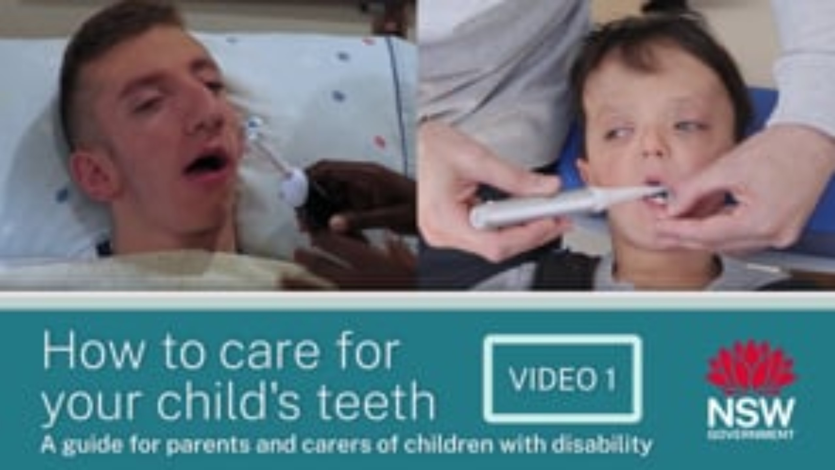
Link to video 'How to Care for your Child's Teeth' – 12 minutes 18 seconds
NSW Health
Notes:
Instructional videos created by Dr Avanti Karve during covid lockdown.

