Slide 1
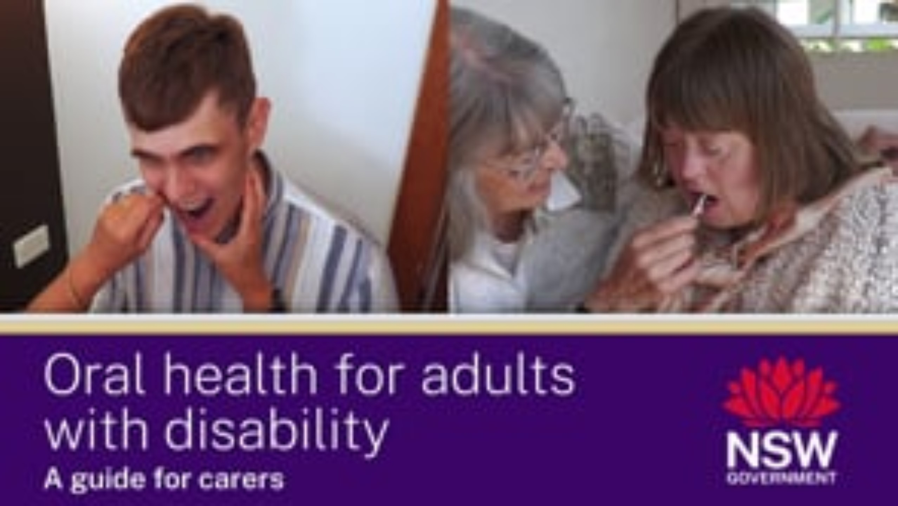
Link to video 'Oral Health for Adults woth Disability' - 14 minutes
NSW Health
Notes:
Instructional videos created by Dr Avanti Karve during covid lockdown.

