Slide 1
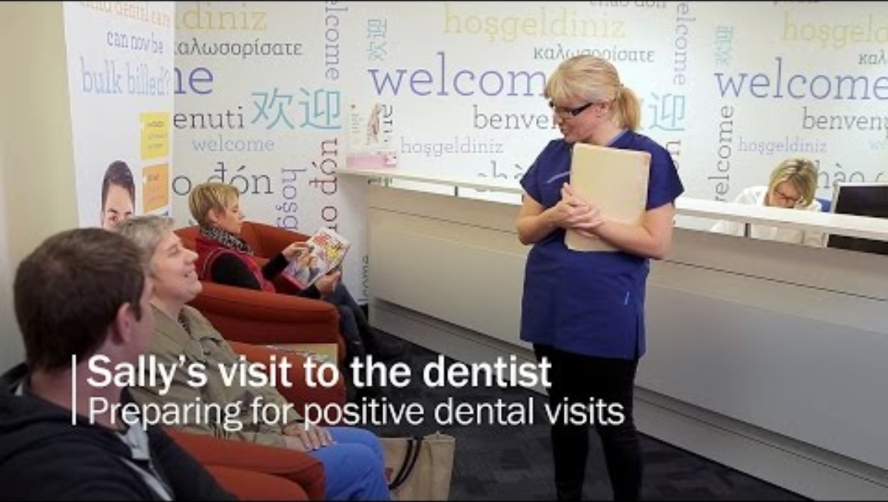
You tube link to video 'Sally's Visit to the Dentist' - 6 minutes and 7 seconds
Oral Health Victoria

