Slide 1
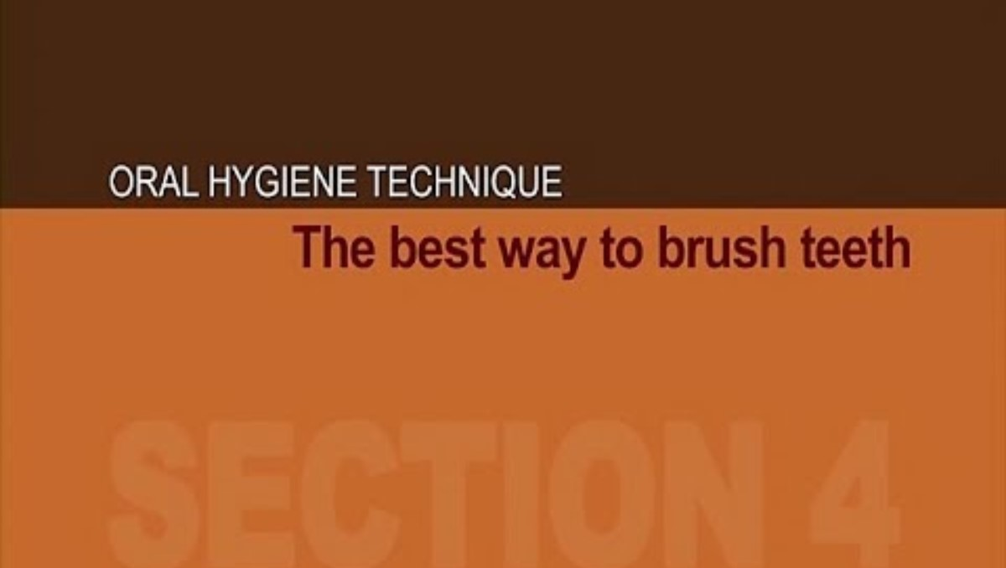
You tube link to video 'The Best Way to Brush Teeth' - 1 minute and 17 seconds
Oral Health Victoria

