Slide 1
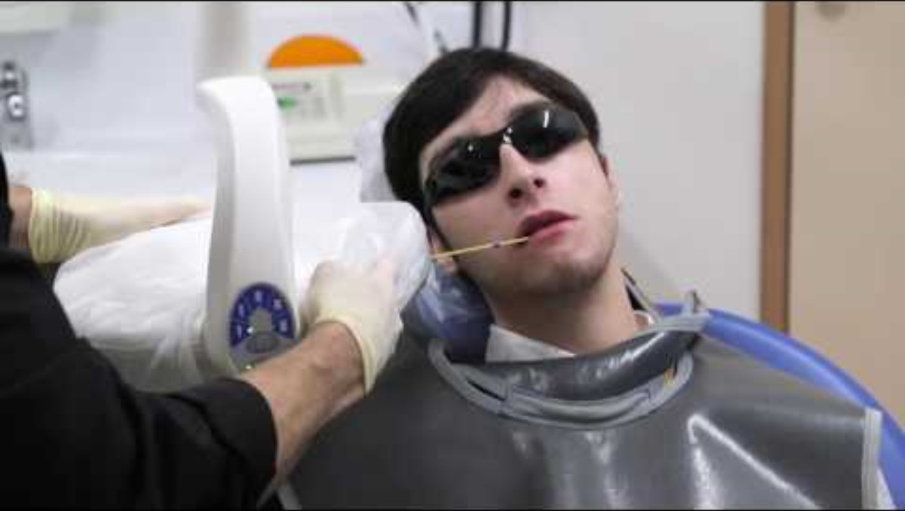
Link to You Tube video 'The Dental x-ray Machine' - 2 minutes and 17 seconds
Inclusion Melbourne

