Slide 1
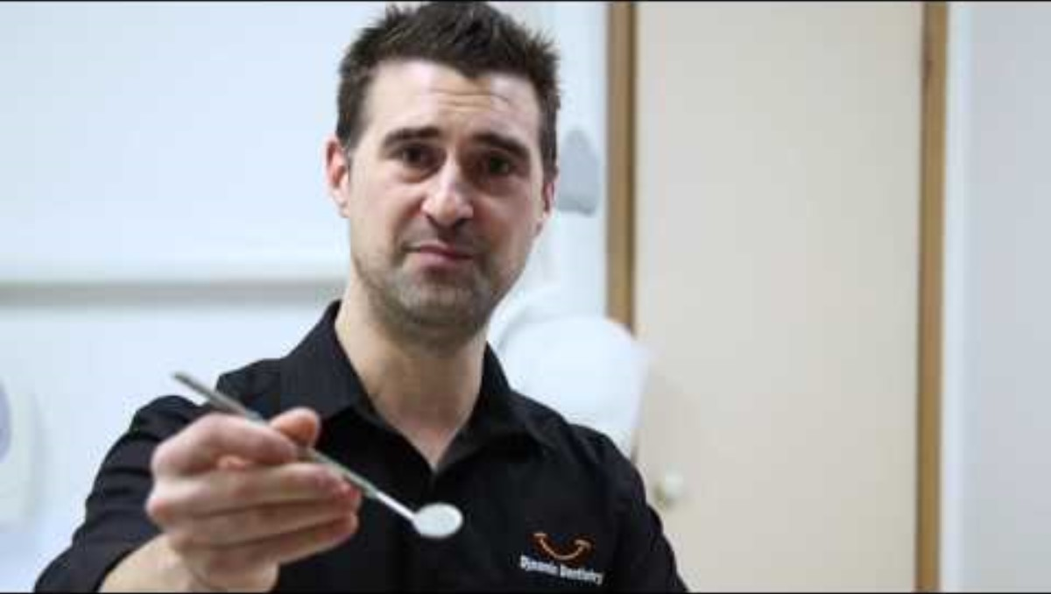
Link to YouTube video 'Types of Dental Equipment' - 1 minute and 56 seconds
Inclusion Melbourne

